Slide 1
Angle-Domain RTM: a Dip-Angle Construction
Raanan Dafni
Annual Report Meeting
TRIP 2016

Slide 2
Outline
RTM
ADCIGν
HOCIG
Beneficial??
ADCIGγ

Slide 3
Subsurface Offset to Angle Domain
HOCIG
Radon Transform Relations:
h
x
x’
ADCIGγ
z
ADCIGν
h
x’
z
z
p
q
ADCIGνγ
h
x’
p
z
q

Slide 4
Subsurface Offset to Angle Domain
Synthetic example: -5º dipping reflector
Image Section (h=0)
HOCIG
kinematic artifacts
ADCIGγ
ADCIGν
ADCIGνγ
γ(º)
ν(º)
-40
-20
0
20
40
-40
-20
0
20
40
50
0
0
ν(º)
0
z(m)
z(m)
-50
2000
2000
0
z(m)
2000
kinematic artifacts
4000
-40
0
40
0
γ(º)
-50
ν(º)
50

Slide 5
Image Quality Enhancement
Dip-domain construction

Slide 6
Dip-Domain Specularity Filter
Filter Design:
ADCIGν
Specularity Filter (F_{spec})
ν(º)
ν(º)
-40
0
40
-40
0
40
0
z(m)
2000
N_{z}
N_{ν}

Slide 7
Dip-Domain Specularity Filter
Dip-Domain Specularity Filter
Kinematic artifacts elimination.
Original
Filtered (W_{spec})
Filtered (W_{diff})
h(m)
h(m)
h(m)
HOCIG:
-2000
0
2000
-2000
0
2000
-2000
0
2000
0
z(m)
2000
ADCIGγ:
γ(º)
γ(º)
γ(º)
-40
0
40
-40
0
40
-40
0
40
0
z(m)
2000

Slide 8
Dip-Domain Specularity Filter
Dip-Domain Specularity Filter
Filter efficiency when velocity errors are present.
90%V
110%V
Original
Filtered (W_{spec})
Original
Filtered (W_{spec})
HOCIG:
ADCIGγ:

Slide 9
Dip-Domain Specularity Filter
Field Data Example (Offshore east Mediterranean Sea):
Image Section (h=0):
HOCIG:
Filtered HOCIG:
Filtered Image Section (h=0):

Slide 10
Dip-Domain Specularity Filter
Field Data Example (Offshore east Mediterranean Sea):
ADCIGγ:
Filtered ADCIGγ:
ADCIGν:
Specularity Filter:

Slide 11
Diffraction Imaging
Dip-domain construction

Slide 12
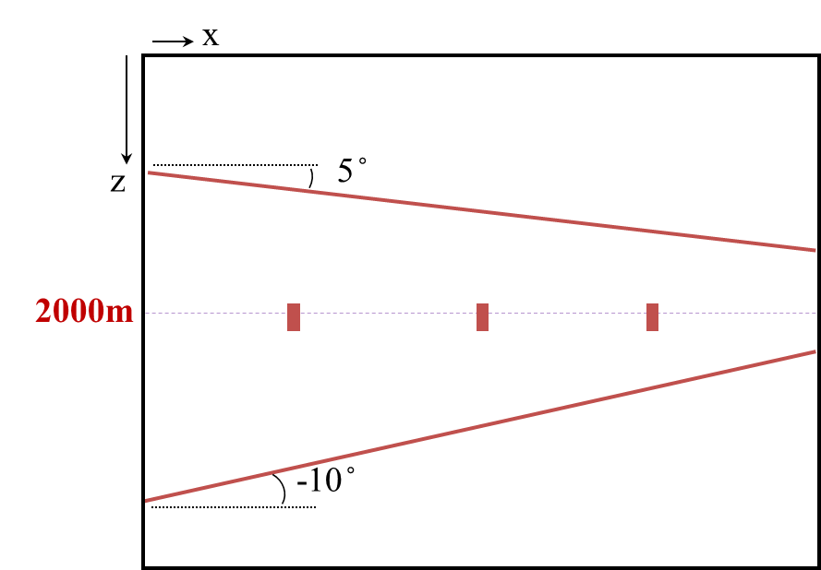
Diffraction Imaging (example#1)
Specularity Filter for Diffraction Imaging:
Separate reflections from diffractions.
x
z
W_{spec}:
W_{diff}:
Specular (Reflections)
Non-Specular (Diffractions)
x
x
z
z

Slide 13
Diffraction Imaging (example#1)
Specularity Filter for Diffraction Imaging:
Separate reflections from diffractions.
Original
W_{spec}:
Specular
(Reflections)
W_{diff}:
Non-Specular
(Diffractions)

Slide 14
Diffraction Imaging (example#1)
Specularity Filter for Diffraction Imaging:
Separate reflections from diffractions.
ADCIGν
Specularity Filter

Slide 15
Diffraction Imaging (example#2)
Specularity Filter for Diffraction Imaging:
Detect faults and small-scale discontinuities.
Velocity
Image Section (h=0)

Slide 16
Diffraction Imaging (example#2)
Specularity Filter for Diffraction Imaging:
Detect faults and small-scale discontinuities.
Specular
Non-Specular

Slide 17
Diffraction Imaging (example#3)
Field data example – Viking Graben (Mobil Corporation, 1994):
Stack section.
cmp(#)
500
1000
1500
2000
0
Un-collapsed hyperbolic curves as indication of diffractions
1
t(s)
2

Slide 18
Diffraction Imaging (example#3)
Field data example – Viking Graben (Mobil Corporation, 1994):
RTM image section (h=0).
cmp(#)
500
1000
1500
2000
0
(Madiba and McMechan, 2003)
1000
1
z(m)
2
PALEOCENE
2000
BCU
PA
JURASSIC
GB

Slide 19
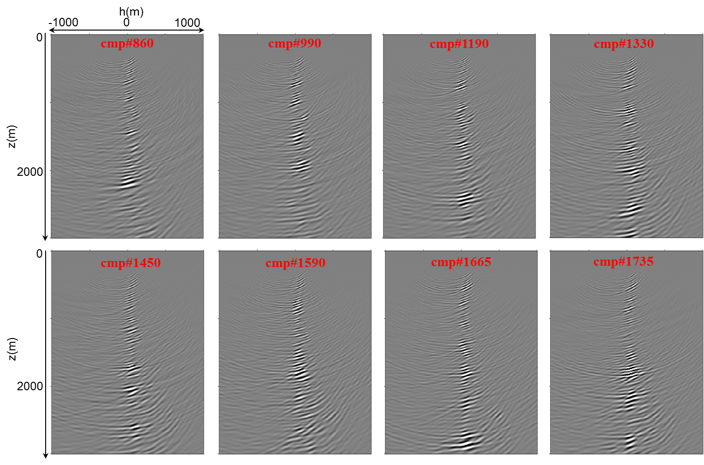
Diffraction Imaging (example#3)
Field data example – Viking Graben (Mobil Corporation, 1994):
HOCIGs.

Slide 20
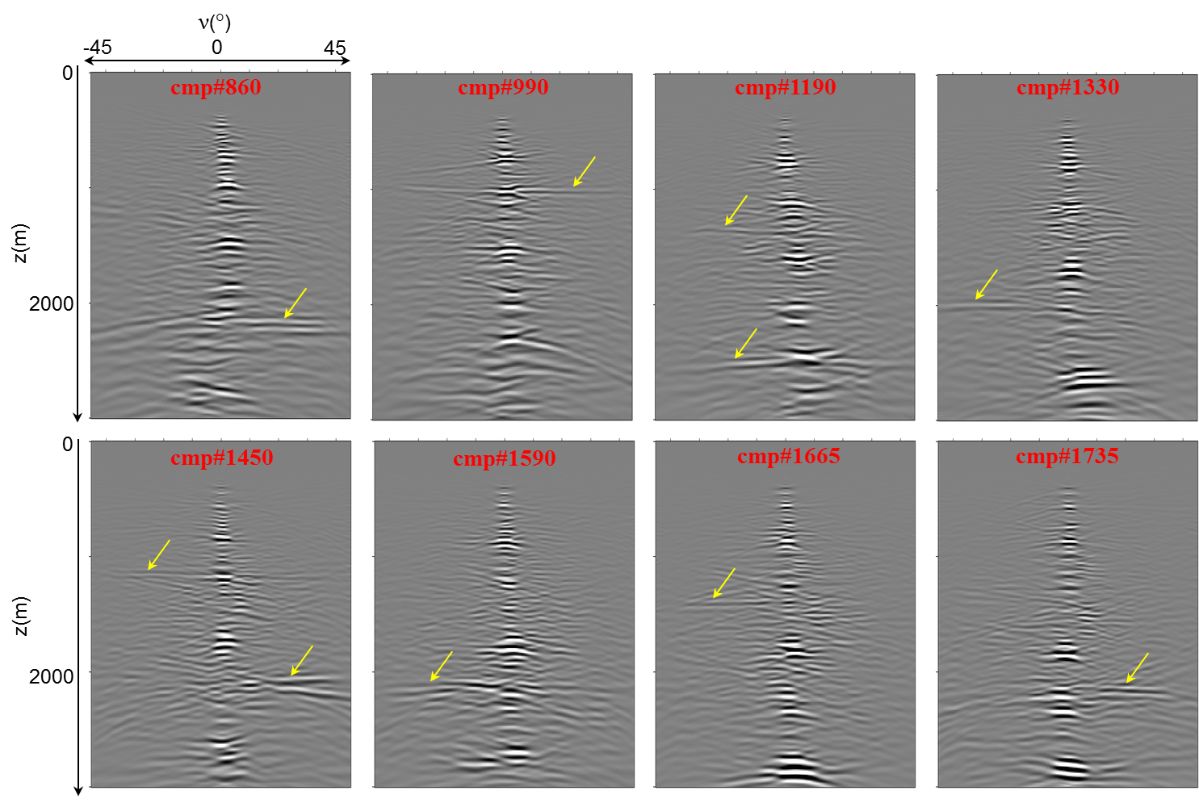
Diffraction Imaging (example#3)
Field data example – Viking Graben (Mobil Corporation, 1994):
ADCIGν.

Slide 21
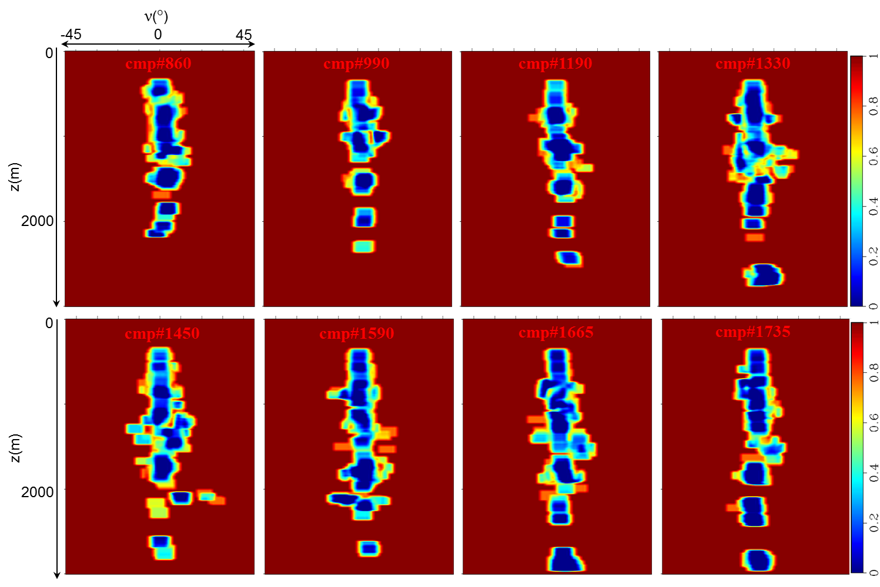
Diffraction Imaging (example#3)
Field data example – Viking Graben (Mobil Corporation, 1994):
Specularity Filter.

Slide 22
Diffraction Imaging (example#3)
Field data example – Viking Graben (Mobil Corporation, 1994):
Before Specularity Filter.
cmp(#)
500
1000
1500
2000
0
1000
z(m)
2000

Slide 23
Diffraction Imaging (example#3)
Field data example – Viking Graben (Mobil Corporation, 1994):
After Specularity Filter.
cmp(#)
500
1000
1500
2000
0
1000
z(m)
2000

Slide 24
Conclusions
Image Interpretation
Velocity Model Optimization
Specular Enhancement
Diffraction Imaging
Reflection Tomography
Migration Velocity Analysis
FWI
ADCIGν
HOCIG
ADCIGγ
Amplitude Analysis
Amplitude Variation with Angle (AVA)
Angle-Domain Technology, based on Wave-Equation Methods.

Slide 25
Acknowledgments:
The Rice University Inversion Project (TRIP) members and sponsors.
Shell International Exploration and Production Inc. for their sponsorship.
The Israeli Ministry of National Resources for partial financial support.
Thank you!

