Slide 1
Raanan Dafni,
PhD in Geophysics (Tel-Aviv University)
Paradigm R&D (2009-2014)
Post-Doc (Rice University)
Current Interest: “Wave-equation based imaging/inversion methods in the angle-domain”

Slide 2
Angle Decomposition via Subsurface Offset Extended RTM
Raanan Dafni
Annual Report Meeting
TRIP 2016

Slide 3
Outline
Subsurface offset extended wave-equation migration
Subsurface offset relations with the angle-domain
Angle decomposition (scattering, dip, multi-angle)
Examples
Future implications

Slide 4
Subsurface Offset Extension
Common Image Gathers (CIGs) are calculated by prestack depth migration methods.
Reflectivity is ‘extended’ by a characteristic prestack parameter:
acquisition offset / scattering-angle / subsurface offset (horizontal)
S
R
Y
X
h
h
M
M

Slide 5
Subsurface Offset Extension
Subsurface offset extended migration operator (Stolk et al., 2009):
S
R
Y
X
h
h
M

Slide 6
Subsurface Offset Extension
Synthetic example: -5º dipping reflector
Image Section (h=0)
HOCIG
110%V
100%V
90%V

Slide 7
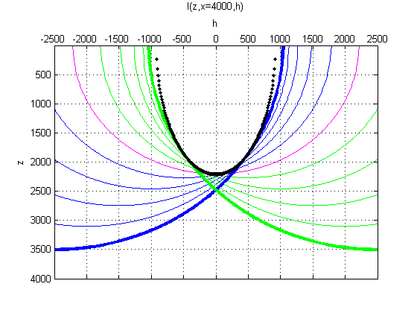
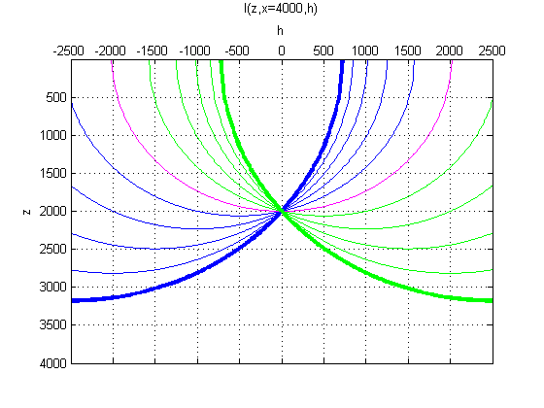
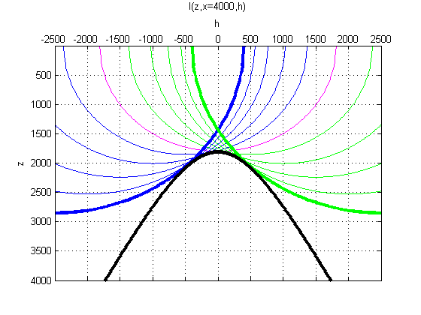
Subsurface Offset Extension
Extended Impulse Response:
HOCIG
110%V
100%V
90%V

Slide 8
Subsurface Offset to Angle Domain
Geometry of Reflection:
h=0
h!=0
s
r
s
r
ν
ν
ν
γ
γ
γ
γ
h
h
M
M
Common Reflection Point (CRP)
Split Reflection Point (SRP)

Slide 9
Subsurface Offset to Angle Domain
Radon Transform Relations:
I[z, x, h]
2D
scattering angle (γ)
(Sava and Fomel, 2003)
dip angle (ν)
(Dafni and Symes, 2016)
I[z, x, y, h_{x}, h_{y}]
3D
scattering angle and azimuth (γ₁, γ₂)
dip angle and azimuth (ν₁, ν₂)

Slide 10
Subsurface Offset to Angle Domain
HOCIG
Radon Transform Relations:
h
x
x’
ADCIGγ
z
ADCIGν
h
x’
z
z
p
q
ADCIGνγ
h
x’
p
z
q

Slide 11
Angle Domain Decomposition
Synthetic example: -5º dipping reflector
Image Section (h=0)
HOCIG
ADCIGγ
ADCIGν
ADCIGνγ
γ(º)
ν(º)
-40
-20
0
20
40
-40
-20
0
20
40
50
0
0
ν(º)
0
z(m)
z(m)
-50
2000
2000
0
z(m)
2000
4000
-40
0
40
0
γ(º)
-50
ν(º)
50

Slide 12
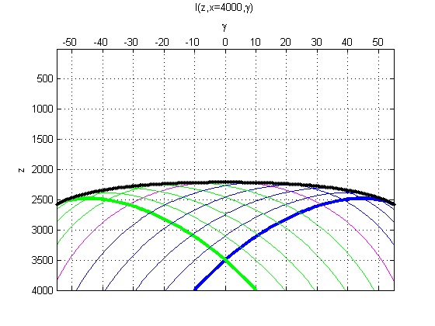
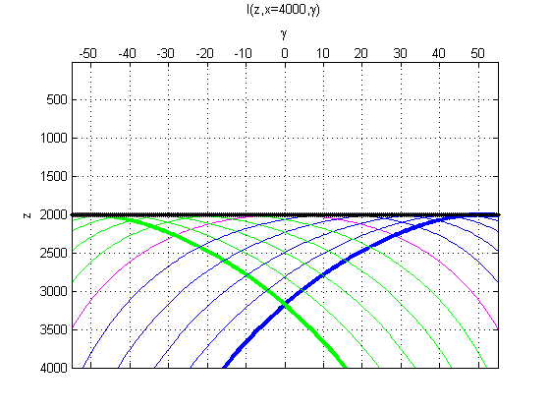
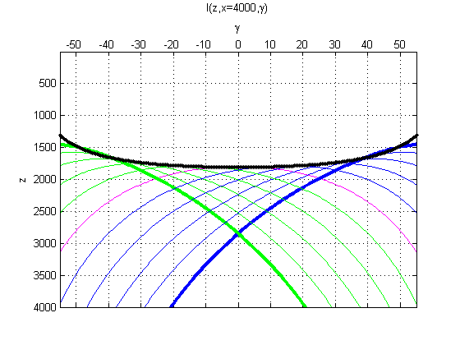
Scattering-Angle Domain (ADCIGγ)
Extended Impulse Response – Angle Variant:
Parametric RT
ADCIGγ
110%V
100%V
90%V

Slide 13
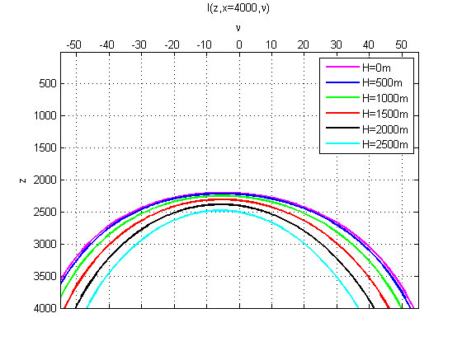
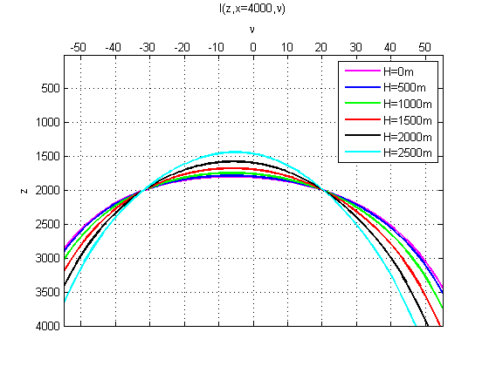
Dip-Angle Domain (ADCIGν)
Extended Impulse Response – Angle Variant:
Parametric RT
ADCIG$ν$
ν(º)
ν(º)
ν(º)
-40
0
40
-40
0
40
-40
0
40
0
110%V
0
100%V
0
90%V
z(m)
2000
2000
2000

Slide 14
Dip-Angle Decomposition (reflections)
The dip-angle response of reflections
Q: Where have the response “tails” gone?
ADCIGν
ADCIGν Kirchhoff
ν(º)
ν(º)
-40
-20
0
20
40
-40
-20
0
20
40
0
0
z(m)
z(m)
2000
2000
The same specular dip information is provided.
The “tails” of the response are annihilated.

Slide 15
Dip-Angle Decomposition (reflections)
The dip-angle response of reflections
Q: Where have the response “tails” gone?
The tails are distractively canceled while imaging in the subsurface offset domain,
before the angles are decomposed.
A: It is a property of imaging methods in the subsurface offset domain.

Slide 16
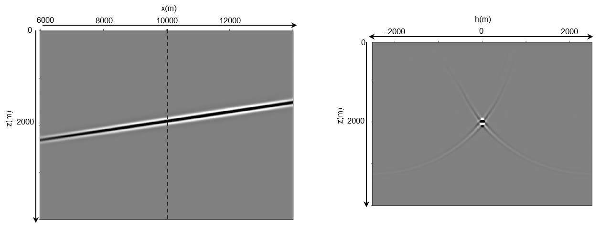
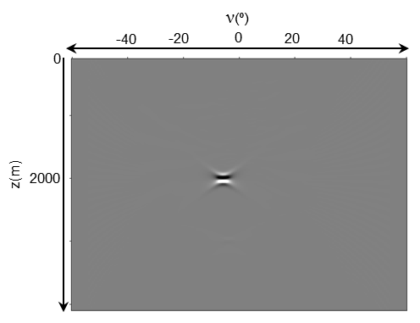
Dip-Angle Decomposition (reflections)
The dip-angle response of reflections
Q: Where have the response “tails” gone?
Subsurface offset extended Kirchhoff migration:
Image Section (h=0)
HOCIG
ADCIGν
A: It is not a property of the imaging method.

Slide 17
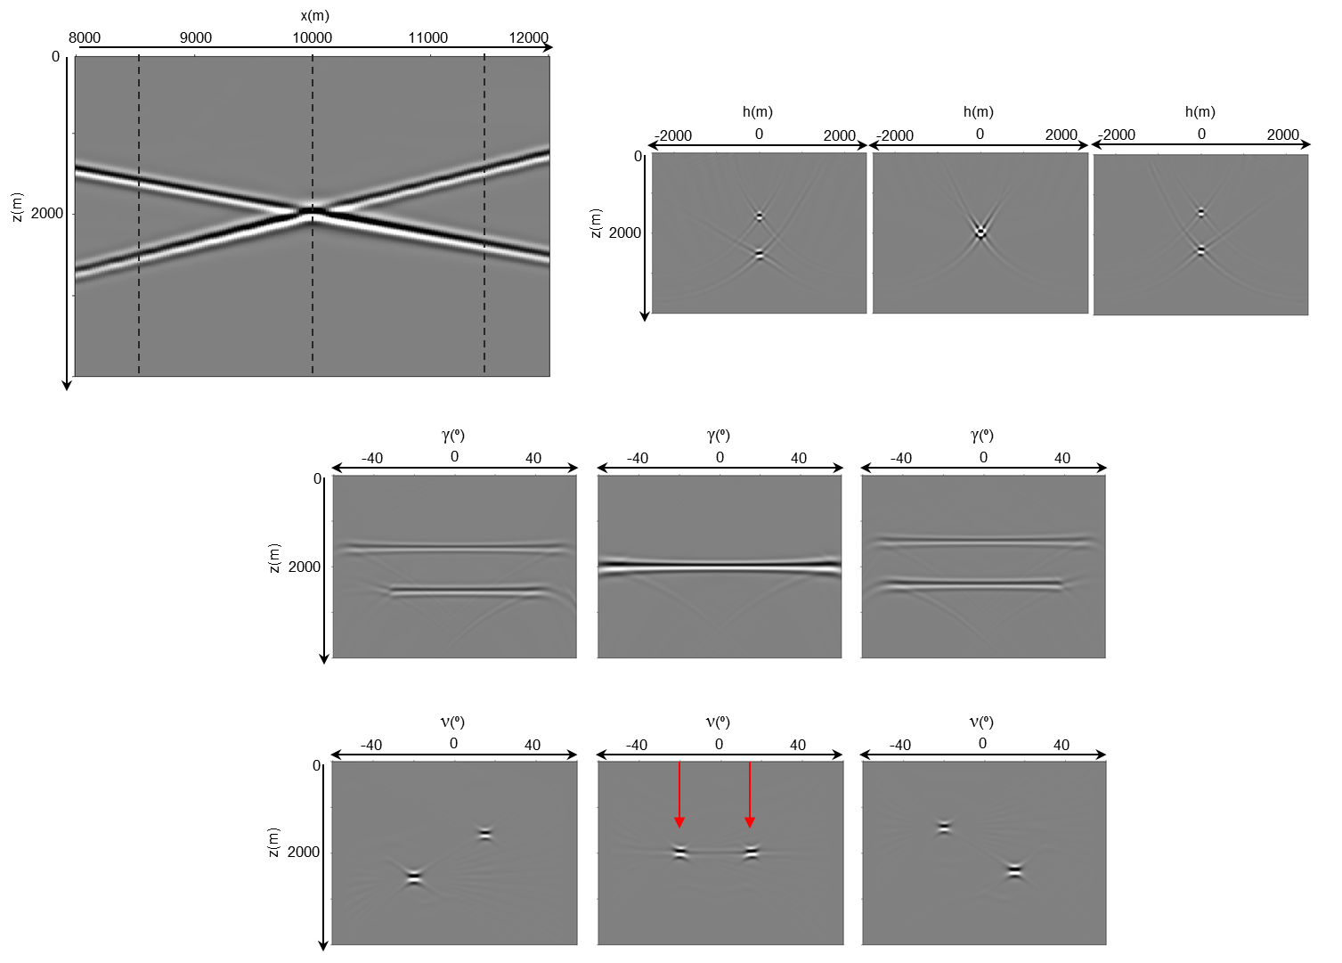
Conflicting Dips
Image Section (h=0)
HOCIG
-20º
15º
ADCIGγ
ADCIGν
-20º
15º

Slide 18
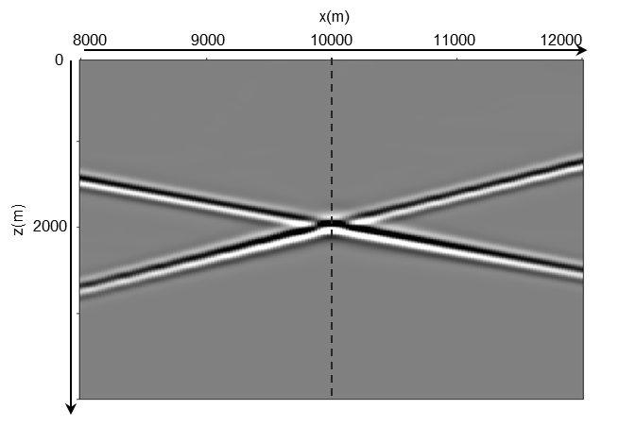
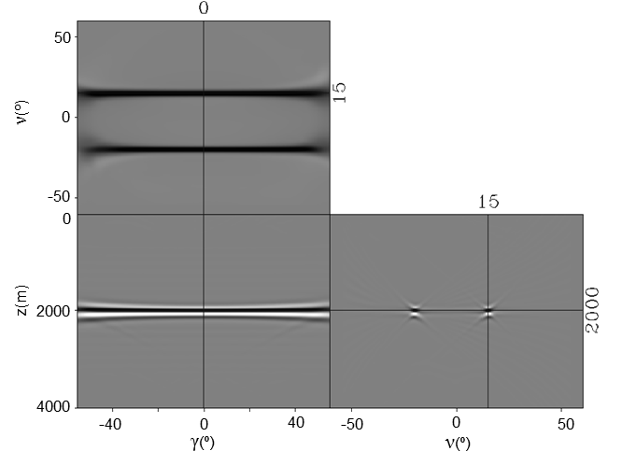
Conflicting Dips
Image Section (h=0)
-20º
15º
ADCIGνγ
15º
-20º
-20º
15º

Slide 19
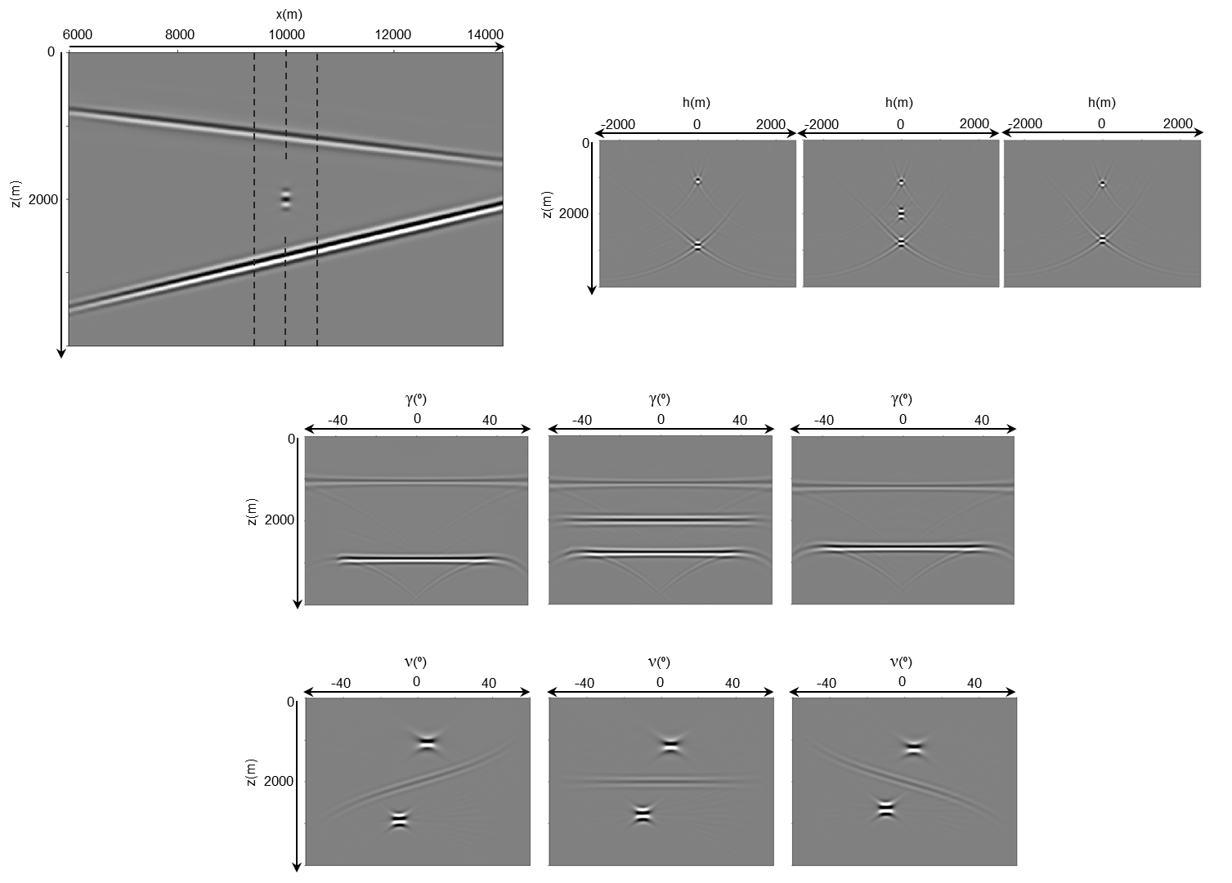
Seismic Diffractions
Image Section (h=0)
HOCIG
5º
-10º
ADCIGγ
ADCIGν

Slide 20
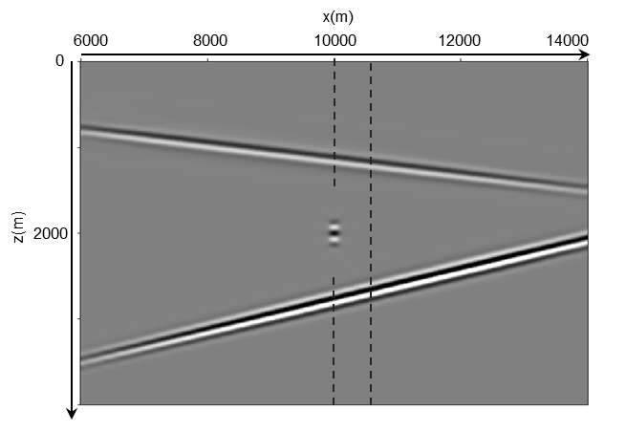
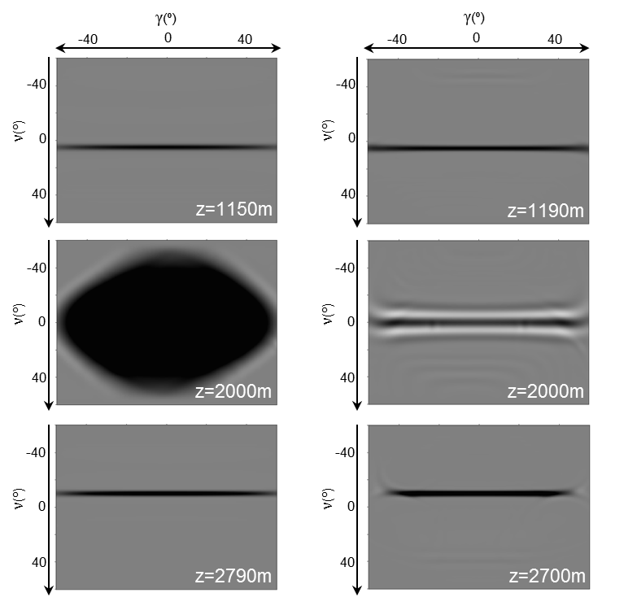
Seismic Diffractions
Image Section (h=0)
ADCIGνγ (depth slices)
Above Diffractor
To the right of Diffractor
5º
-10º

Slide 21
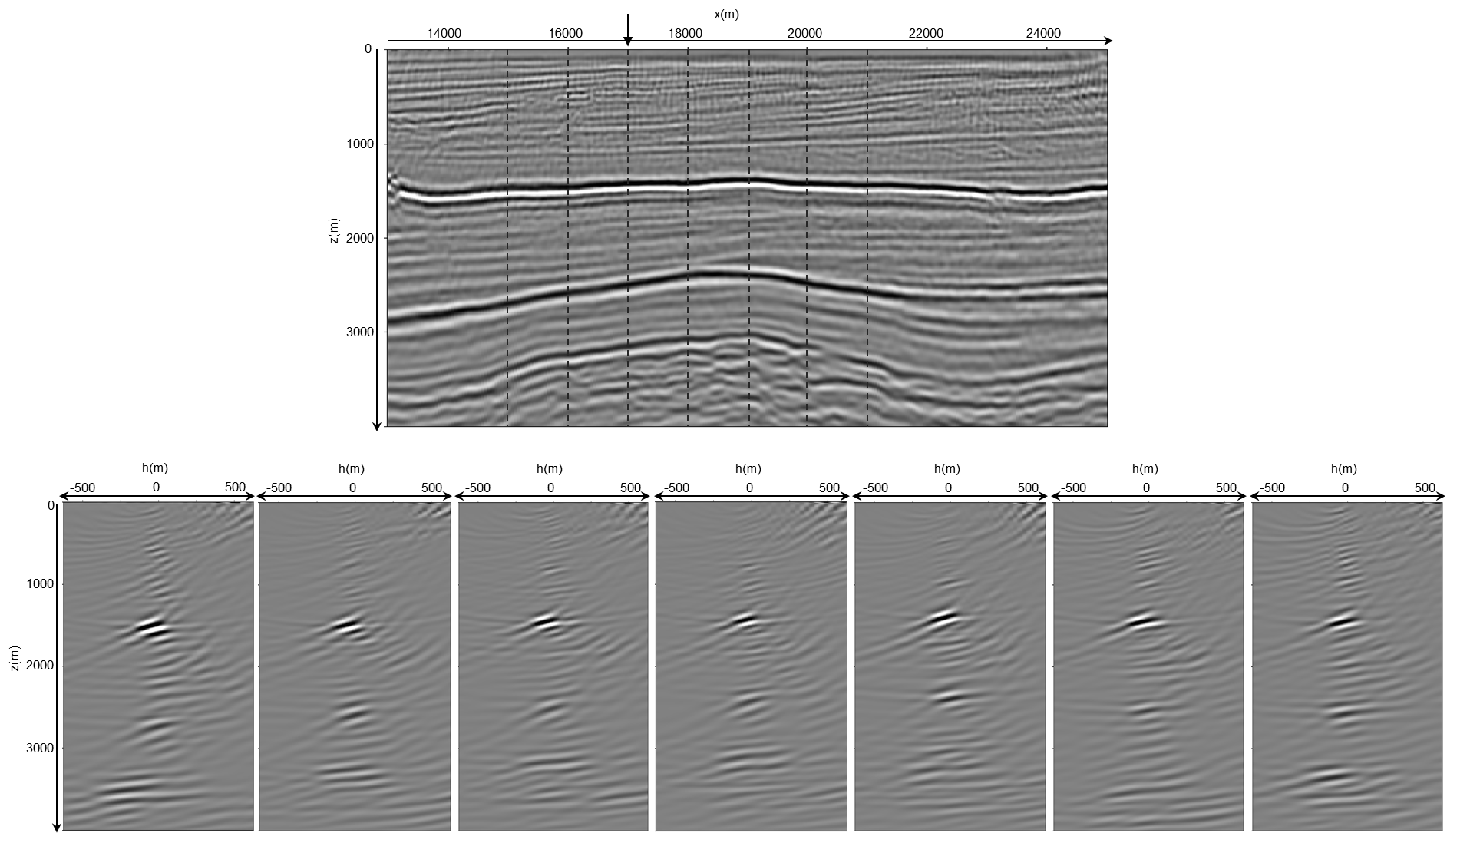
Field Data Example
2D line, Offshore east Mediterranean Sea.
Image Section (h=0)
HOCIG

Slide 22
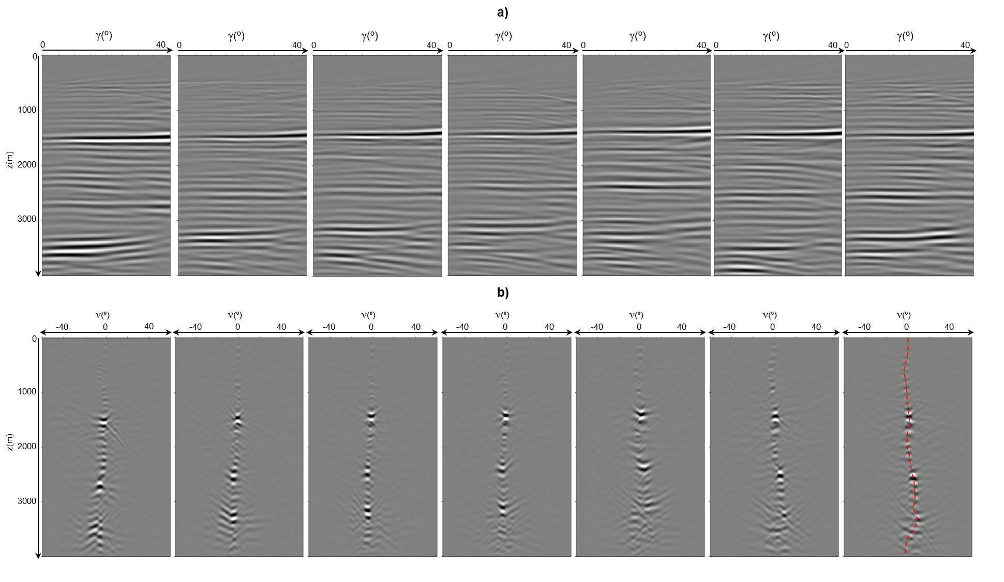
Field Data Example
2D line, Offshore east Mediterranean Sea.
ADCIGνγ (depth slices)
ADCIGγ
ADCIGν

Slide 23
Future Implications
ADCIGν
HOCIG
ADCIGνγ
ADCIGγ
Image Interpretation
Velocity Model Optimization
Amplitude Analysis
Specular Enhancement
Diffraction Imaging
Reflection Tomography
Migration Velocity Analysis
FWI
Amplitude Variation with Angle (AVA)
Angle-Domain Technology, based on Wave-Equation Methods.

Slide 24
Acknowledgments:
The Rice University Inversion Project (TRIP) members and sponsors.
Shell International Exploration and Production Inc. for their sponsorship.
The Israeli Ministry of National Resources for partial financial support.
Thank you!

