Slide 1
Papia Nandi-Dimitrova
Education
Rice University, PhD Geophysics 2012-Present
University of Wyoming, MS Geophysics 2005
University of Illinois, Urbana-Champaign
BS Computer Science 2002
BS Finance 1997
Experience
BP 2006-2015
Exploration, production, processing, imaging R&D
Conoco-Phillips, Chevron, LBNL, NCSA,+

Slide 2
Common-offset Extended Full-Waveform Inversion
Papia Nandi-Dimitrova
Uwe Albertin

Slide 3
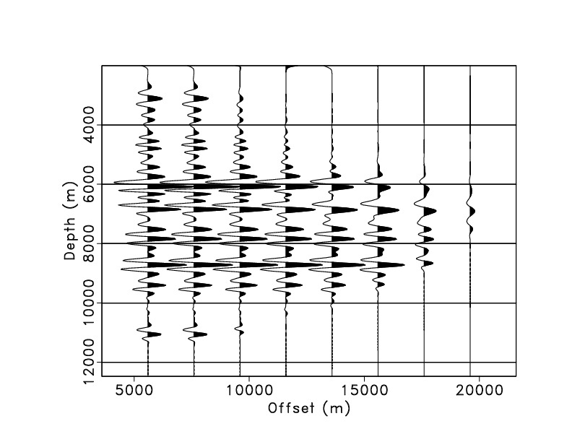
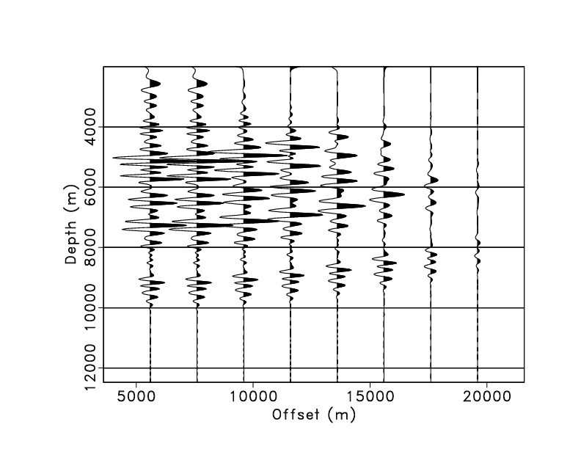
EFWI: The Extended Domain
Notes:
In the extended domain, here’s an example on synthetic data of how it works. On the left is a trace with some reflectivity on it and all the reflectors line up as you go across the horizontal axis, which is the extended axis – here in the offset domain. If they all line up, then the background velocities are also the same. On the right, the background long wavelength velocities are changing and as you go from one offset to its neighbor, you see moveout. This would indicate to the inversion that there is an error in the background velocity model and it modifies it accordingly. But if you stacked all of these traces together, and didn’t have an extended model like in FWI, there would be no way to tell if the background velocity was ok or not, and you’d have to just assume that it was.

Slide 4
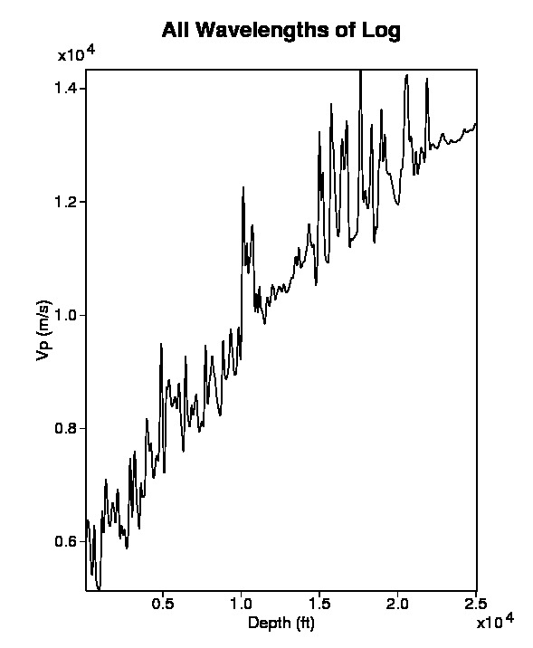
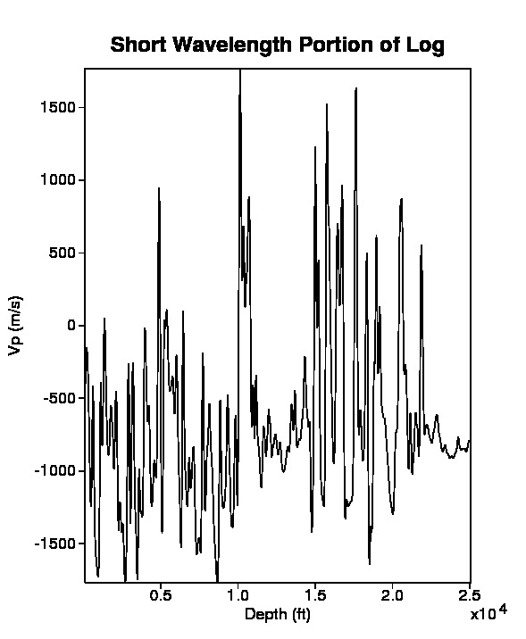
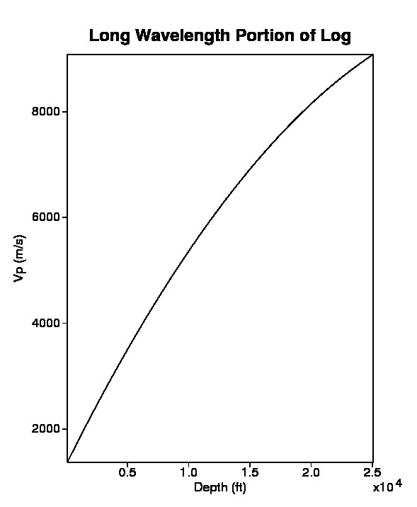
EFWI: Separation of Scales
Log data: Kansas Geological Survey, 2011
Notes:
EFWI relies on the separation of scales in the velocity model, which is a little hard to visualize, so let me show an example using a well log. The left-most image is something you might collect out in the field. Depth is increasing on the horizontal axis and velocity is increasing with depth. This well log has two parts to it. The rightmost image shows the background velocity to the trend. It follows a smooth path and averages what the well log is doing. There are no oscilations and in the background model, there is no reflectivity. The middle image is the reflectivity or short wavelength part of the velocity model. It is the oscillatory part. If it were synthetic data, and I was a better processor, there would be no background trend to it – it would be wiggling centered around 0. However there still seems to be a little left over. The left most model is the total velocity model, m. It is the sum of delta m, or r for reflecitivity and m_l which is the long wavelength portion of the velocity model. I will be using both delta m and r to describe the middle picture during this presentation.

Slide 5
EFWI: Two loops
Fit
Fit
modify
modify
Notes:
EFWI is executed in two different loops in order to fit each of these wavelength scales separately. The inner loop fits only the reflectivity – like least squares migration. Once this is fit, the velocity model can successfully predict the data to below some small error threshold and we set F[m] –d = 0. Then the outer loop fits the background model by looking at the velocities in the extended domain – across shots or plane waves or offset.

Slide 6
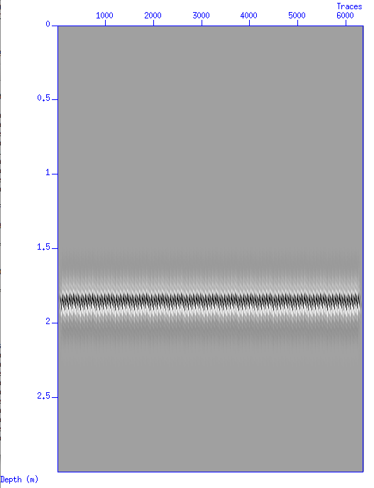
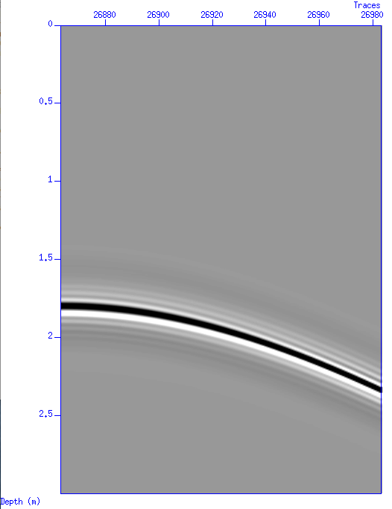
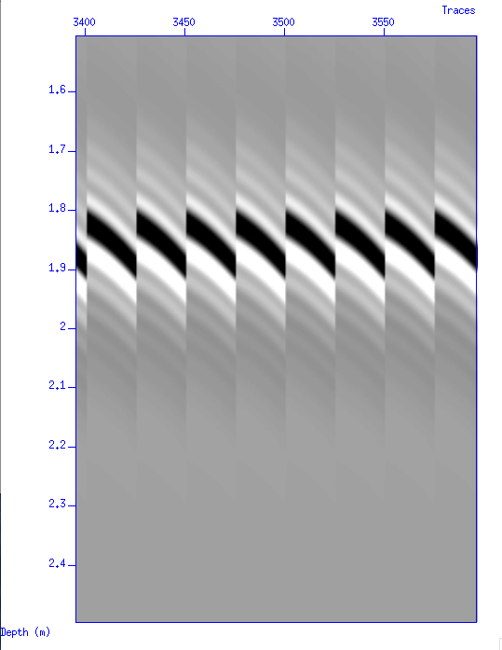
Motivation
offset=h
Offset domain vs shot
larger aperture
smaller aperture
shot gather
common offset bin

Slide 7
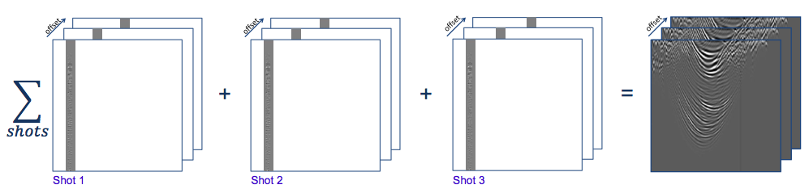
Dividing data into bins
h
Nandi-Dimitrova & Etgen, 2016

Slide 8
Least-Squares Migration (inner loop)
c = acoustic velocity
p = pressure
f = source function
G=Greens function solution
δG = perturbation of Greens function
δm = velocity perturbation
x’ = subsurface point at time t’
x_{r} = receiver location at time t
x_{s} = source location at time 0
Constant density acoustic wave-equation
Born forward modeling operator
Notes:
Because we used born forward modeling operator, d’ refers to linearized data= single scatterer, no multiples

Slide 9
LSM (inner loop)
Apply to model perturbation to generate predicted data
Minimize LS objective function
Put gradient into conjugate gradient solver for model update
h’=common offset bin center
d_{m}=modeled data
d’=recorded data after demultiple
h= ½ surface offset distance
h’+/- 2h=common offset bin
Notes:
mention delta m is the short wavelength perturbation from scale separation slide

Slide 10
LSM (inner loop)
Apply to model perturbation to generate predicted data
Minimize LS objective function
Put gradient into conjugate gradient solver for model update
h’=common offset bin center
d_{m}=modeled data
d’=recorded data after demultiple
h= ½ surface offset distance
h’+/- 2h=common offset bin
Notes:
mention delta m is the short wavelength perturbation from scale separation slide

Slide 11
LSM (inner loop)
Apply to model perturbation to generate predicted data
Minimize LS objective function
Put gradient into conjugate gradient solver for model update
h’=common offset bin center
d_{m}=modeled data
d’=recorded data after demultiple
h= ½ surface offset distance
h’+/- 2h=common offset bin
Notes:
mention delta m is the short wavelength perturbation from scale separation slide

Slide 12
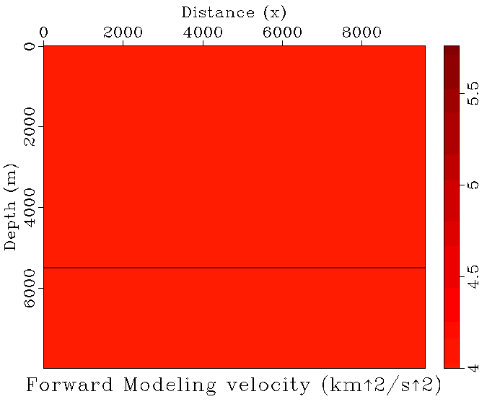
source= bandpassed spike, 2-4-20-25 Hz
4000 – 16650 m, every 50 m (254 shots), 3700 m depth
receivers=4000-19600 m, every 25 m (625 receivers), 3700 m depth
3 seconds recording time, 4 ms sampling
20 m grid spacing in x and z
source= bandpassed spike, 2-4-20-25 Hz
3500 – 5100 m, every 50 m (32 shots), 4000 m depth
receivers=3700-9100 m, every 36 m (625 receivers), 4000 m depth
3 seconds recording time, 4 ms sampling
12 m grid spacing in x and z

Slide 13
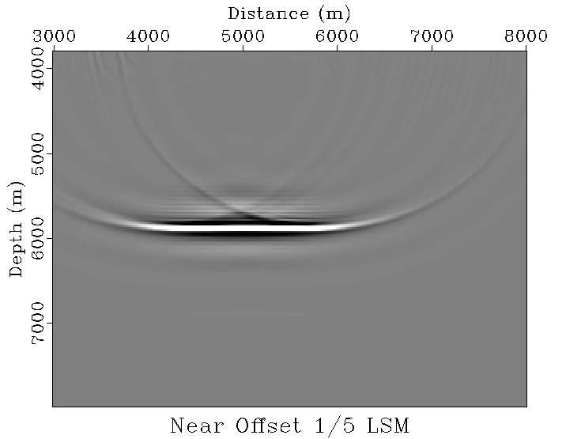

Slide 14
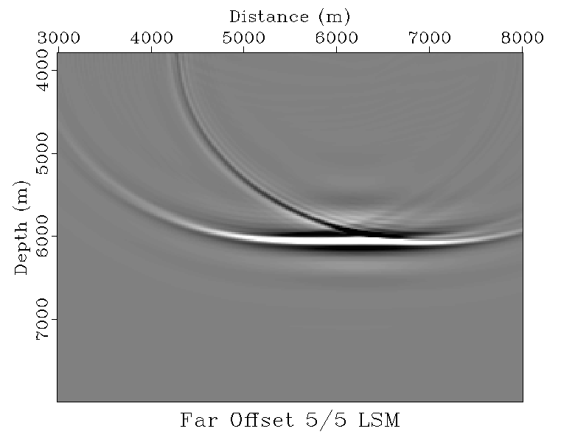

Slide 15
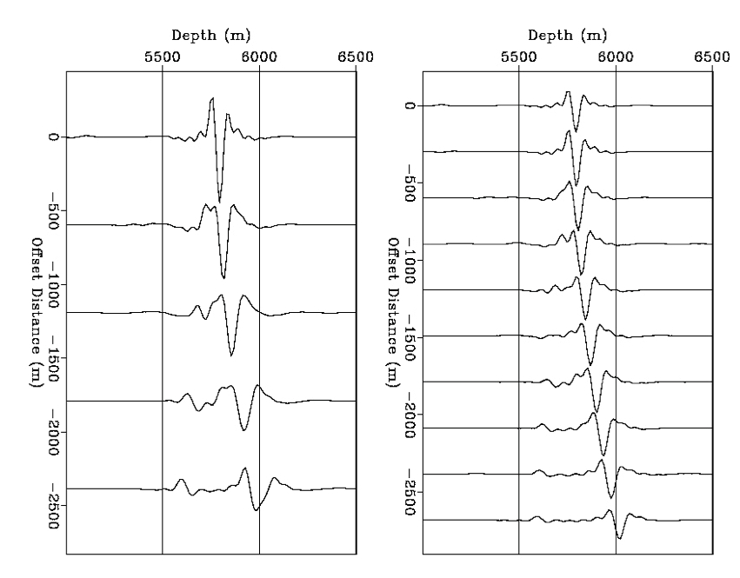
Least-Squares Migrated Gathers
Migrated Image @ x=5000 split into 5 Bins
Migrated Image @ x=5000 split into 10 Bins

Slide 16
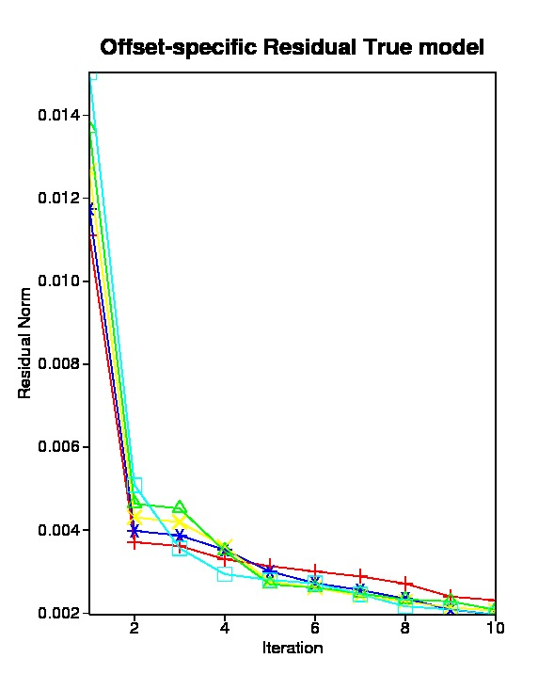
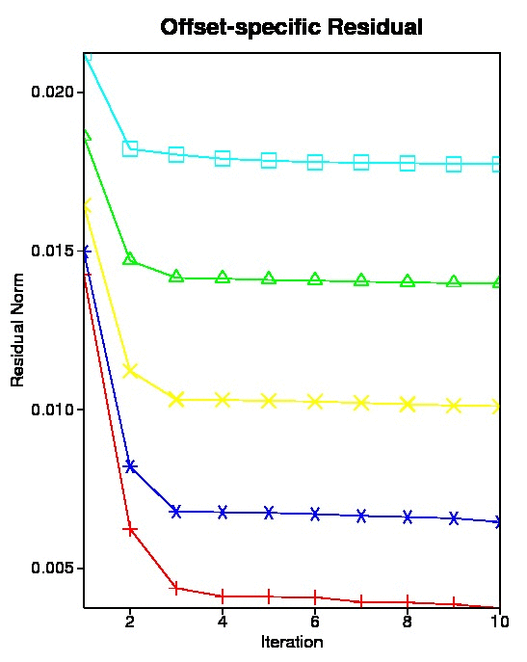
16% data fit
Offset 0 – 79%
Offset 1 – 83%
Offset 2 – 83%
Offset 3 – 85%
Offset 4 – 87%
25%
38%
57%
73%
Notes:
Talk about what this means – that the velocity error was responsible for the crappy data fits. So therefore, LSM has reached its limit of use. Either have to change the velocity model, or stop LSM.

Slide 17
LSM vs RTM
RTM -> adjoint operator
  equivalent to the first iteration of LSM
LSM -> inverse operator
  more balanced amplitudes
  can compensate for imperfect acquisition
Notes:
Both operate on the short-wavelength component of the data to produce an image.

Slide 18
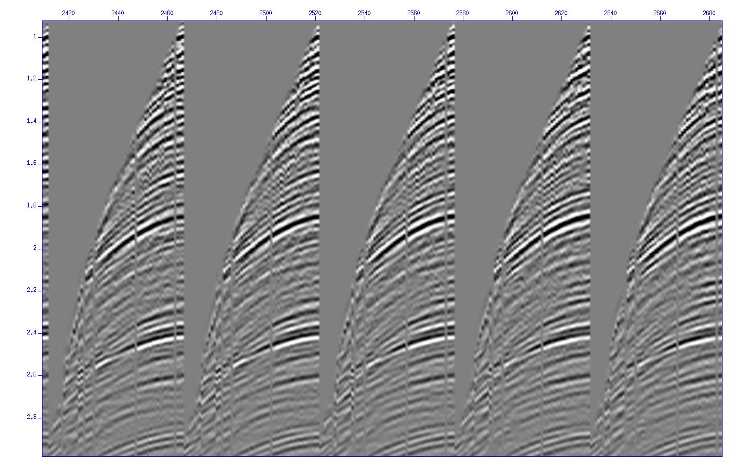
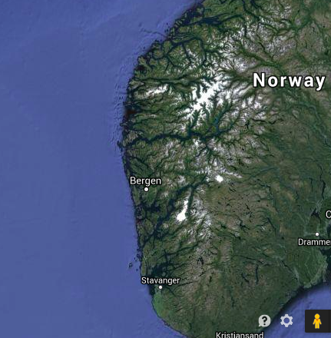
Field Area: Viking Graben
Notes:
We also intend to implement EFWI on towed streamer data – a type of marine data that is much more prevalent in the industry. The kinds of problems we saw with sparcity will likely not affect the outcome of this study, but differences may largely attributed to computational feasibility and the differences of coherent noise or multiples in each domain.

Slide 19
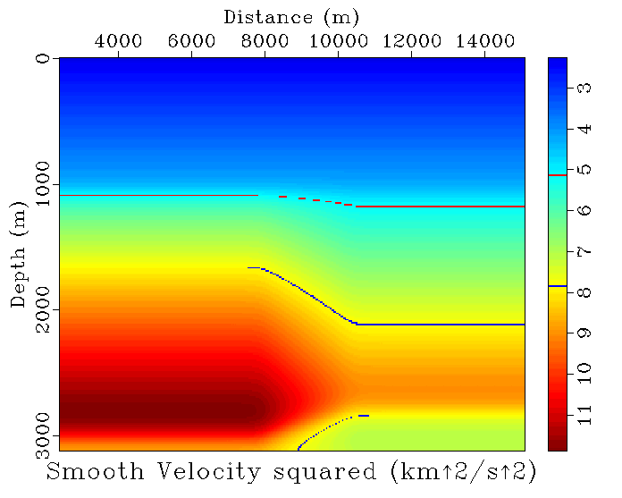
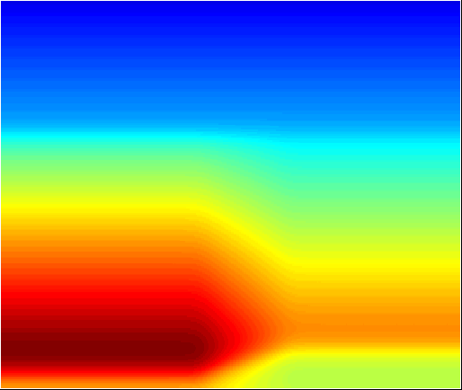
Notes:
Velocity LW from semblance analysis

Slide 20
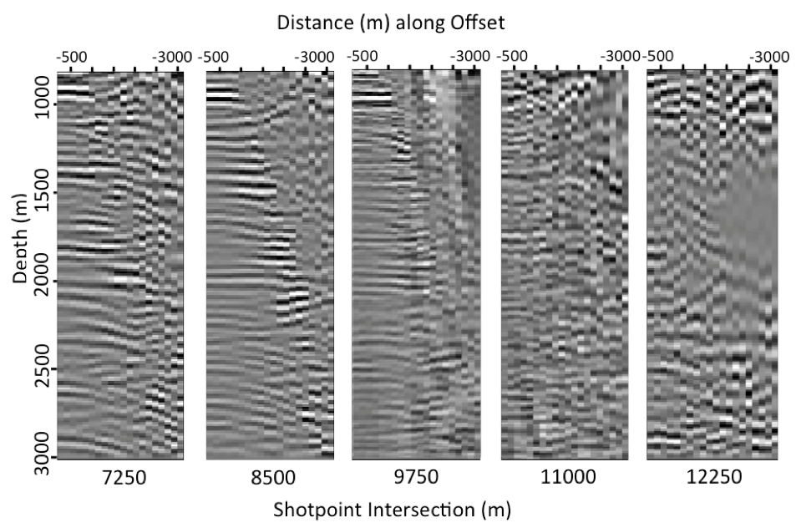
CORTM Gathers

Slide 21
EFWI: Two loops
Fit
Fit
modify
modify
Notes:
EFWI is executed in two different loops in order to fit each of these wavelength scales separately. The inner loop fits only the reflectivity – like least squares migration. Once this is fit, the velocity model can successfully predict the data to below some small error threshold and we set F[m] –d = 0. Then the outer loop fits the background model by looking at the velocities in the extended domain – across shots or plane waves or offset.

Slide 22

DSO (outer loop)
Gradient calculated through Variable Projection Method (Golub and Pereyra, 2003 )
DSO on offset gathers has precedence (Mulder and ten Kroode, 2002, Chauris and Noble, 2001)
This method/code was developed in Yin Huang’s thesis (2016), except in the shot domain. We expect improved results in the common-offset domain because of a larger aperture.
D²F^{T} = tomographic operator, or the transpose
of the 2nd derivative of the Born Operator

Slide 23
Future Work
Synthetic tests on more complex models that cannot be solved via FWI
Gradient calculation via Variable Projection/Huang 2016
Application to field data
TRIP sponsors, Texas Advanced Computing Center, developers of Seismic Unix, Madagascar & iWave
Thank you

