Slide 1
Raanan Dafni,
Dual BSc in Geophysics and Chemistry (Tel-Aviv University).
PhD in Geophysics (Tel-Aviv University).
Paradigm Geophysics R&D (2009-2014).
Post-Doc (Rice University).

Slide 2
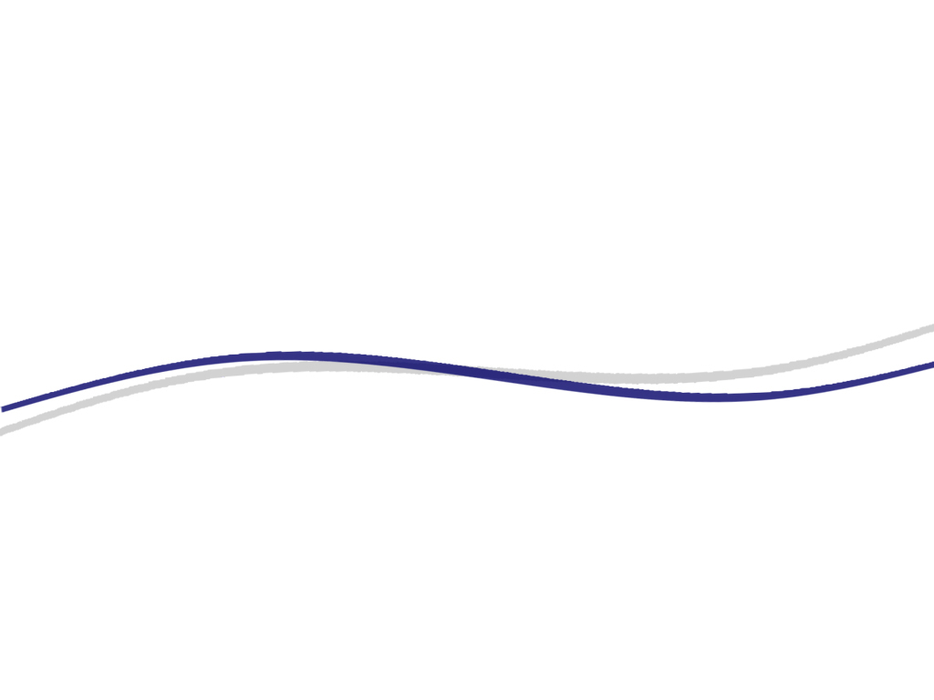

Wave Equation Angle Domain
Image Gathers
Raanan Dafni
Annual Meeting
TRIP 2015

Slide 3
Extended Depth Imaging
Common Image Gathers (CIGs) are calculated by Pre-Stack Depth Migration (PSDM).
The image is extended by a characteristic parameter.
Usually this parameter refers to the acquisition offset, scattering-angle, subsurface offset, source index, and more…
The image is analyzed (Amplitude and Kinematics) according to its extensions.
Analysis location (X_{i})
Extension Parameter
X
Z
Z
Image Section
CIG at X_{i}

Slide 4
Outline
Local Angle Domain (LAD) image gathers.
The importance of the dip-angle information.
Subsurface-offset image gathers.
Wave-equation angle-domain image gathers.
Conclusions.

Slide 5
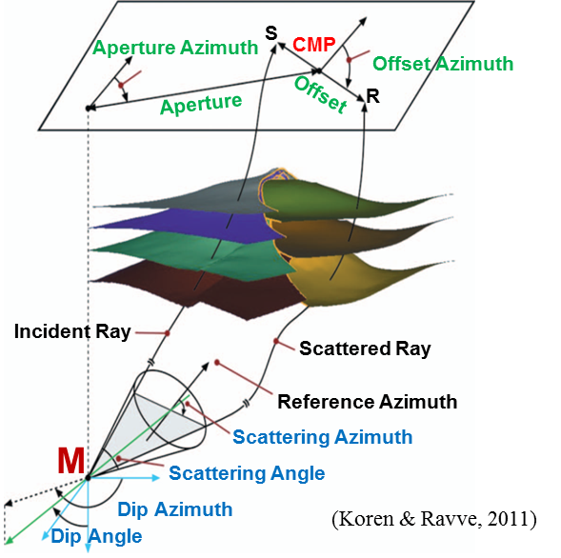
Angle Domain Image Extension
Extend the image in the Local Angle Domain (LAD).
Seismic data is mapped from the recording surface to the LAD by:
  Ray-tracing (Kirchhoff-based imaging).
  Wavefield downward continuation (wave-equation-based imaging).

Slide 6
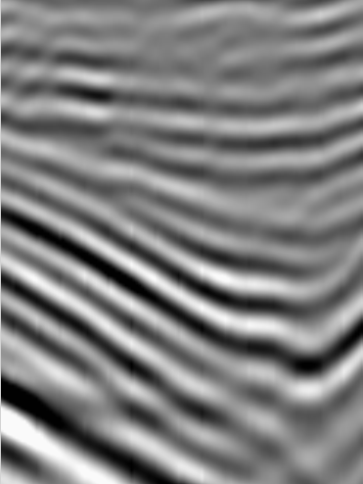
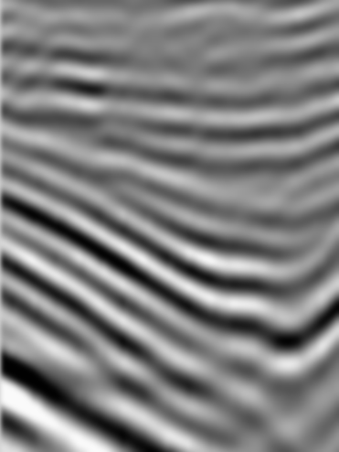
LAD Imaging System
Each image point is represented by 4 (or 2) angle components.
S
R
Y
X
Y
Scattering
Azimuth
γ₂
Scattering
Angle
γ₁
M
ν₂
X
3D case
2D case
Dip
Azimuth
ν₁
Dip
Angle

Slide 7
LAD Image Gathers
LAD imaging system:
Subsurface angular characterization.
Interpret the image by subsurface model parameters (not data parameters).
Reflectivity is recovered explicitly as a function of the scattering-angle.
Multivalued ray-paths are naturally unfolded.
5D data is mapped into 7D image space.
Do the data know something we don’t?
  YES!
  Subsurface model properties (velocity).
  Subsurface structure (specular dip).

Slide 8
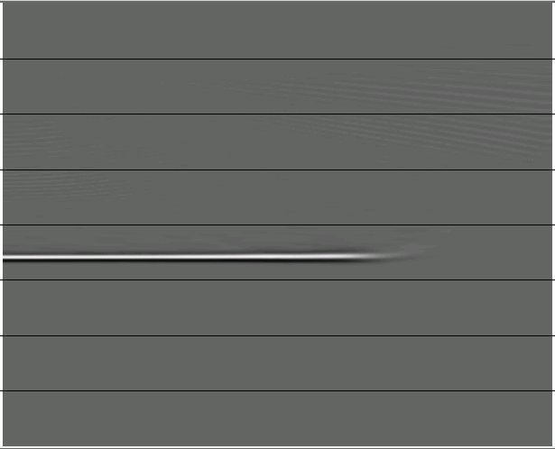
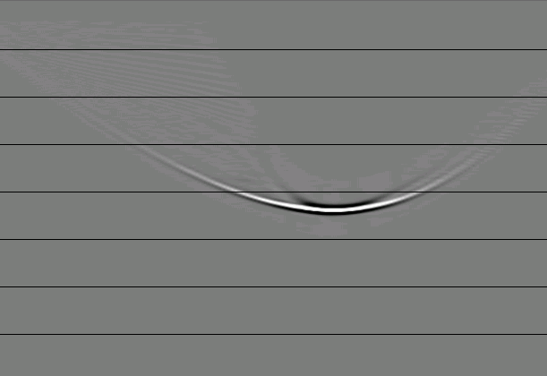
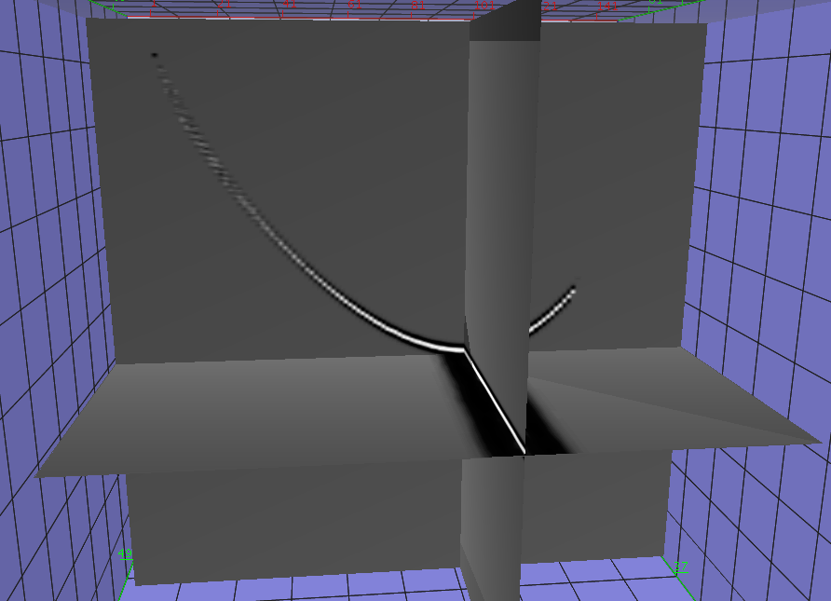
LAD Image Gathers (Kirchhoff-based)
CIG
Scattering-angle CIG
Dip-angle CIG
0
30
70
-70
-30
0
30
70
0
γ₁[ ̊ ]
0
ν₁[ ̊ ]
2200[m]
15 ̊
2000
2000
Z[m]
Z[m]
Multi-Parameter CIG
ν₁
γ₁
ν₁
Z
γ₁
Z = 2200[m]
Z
(Dafni & Reshef, 2012, 2014, 2015)

Slide 9
Dip-Angle Image Gathers
The importance of the dip information:
Essential structural information is “hidden” in the dip-angle CIGs.
-70
-30
0
30
70
0
ν₁[ ̊ ]
2000
Z[m]

Slide 10
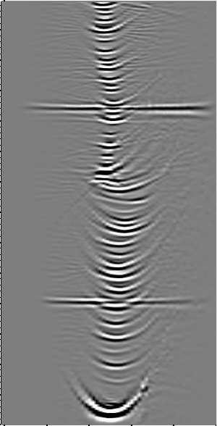
Dip-Angle Image Gathers
The importance of the dip information:
Essential structural information is “hidden” in the dip-angle CIGs.
Seismic diffractions can be distinguished from seismic reflectors in the dip-angle domain.
-70
-30
0
30
70
0
ν₁[ ̊ ]
4000
Z[m]

Slide 11
Dip-Angle Image Gathers
The importance of the dip information:
Essential structural information is “hidden” in the dip-angle CIGs.
Seismic diffractions can be distinguished from seismic reflectors in the dip-angle domain.
Seismic diffractions are highly sensitive to velocity errors in the dip-angle domain.
-70
-30
0
30
70
0
ν₁[ ̊ ]
4000
Z[m]

Slide 12
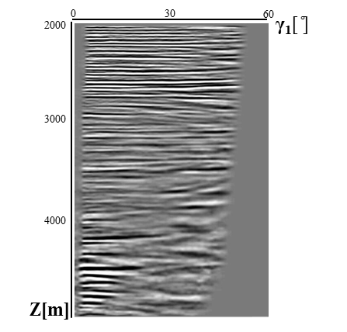
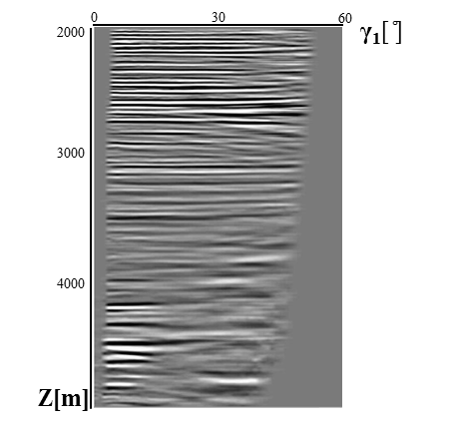
Dip-Angle Image Gathers
The importance of the dip information:
Essential structural information is “hidden” in the dip-angle CIGs.
Seismic diffractions can be distinguished from seismic reflectors in the dip-angle domain.
Seismic diffractions are highly sensitive to velocity errors in the dip-angle domain.
Scattering-angle CIGs can be of limited use for velocity analysis in regions with complex geologic structures. The essential dip-angle information can be incorporated in the generation stage of the scattering-angle CIGs to improve the assurance and quality of the gathers.
Incorporate dip information

Slide 13
LAD Image Gathers (Wave-equation-based)
LAD CIGs are computed in relation with wave-equation migration by:
Data-space technique – applied on the wavefields before imposing the imaging condition.
Image-space technique – applied on the prestack images after migration.
Seismic data
HOCIG
Wave-equation-based migration
Slant-Stack
Slant-Stack
ADCIGγ
ADCIGν
(Sava & Fomel, 2003)
(Still to be discovered)

Slide 14

HOCIGs subsurface offset extensions

Slide 15
HOCIGs
Extend the image by the horizontal subsurface offset (h_{x}, h_{y}) to generate HOCIGs.
The horizontal subsurface offset is defined as the horizontal distance between the sunken source and receiver wavefields.
When the true migration velocity is used, the two wavefields will constructively interfere at h=0. Therefore, the image is focused at the zero offset trace in the HOCIGs.
Any offset other than h=0 will be considered as non-physical.
Y
S
R
X
h

Slide 16
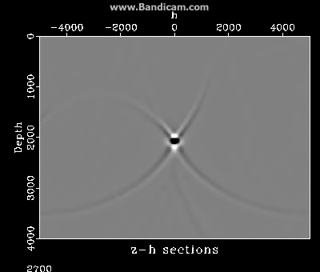
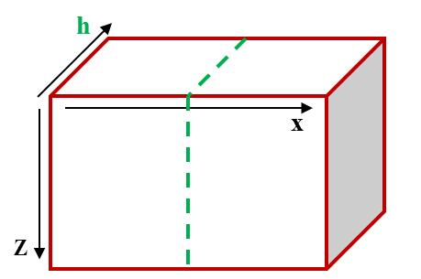
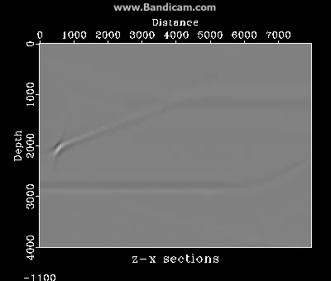
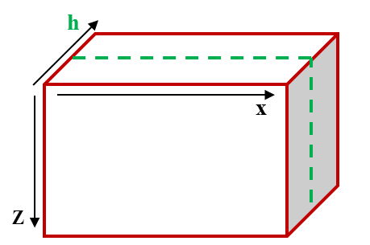
HOCIGs
CIG
2000[m]
The image is focused at h=0.
Some energy is “leaking” to non-zero offsets since:
  Frequency band is limited.
  Acquisition geometry is bounded.

Slide 17
Extended Impulse Response Test (H=0)
h=0
h!=0
Each point on the circle generates secondary elliptic response.
horizontal Shift (Δx=-h).
Vertical shortening (circle to ellipse).
Traveltime is conserved.
S
R
S’
R’
x₀-h
x₀
h
x
z

Slide 18
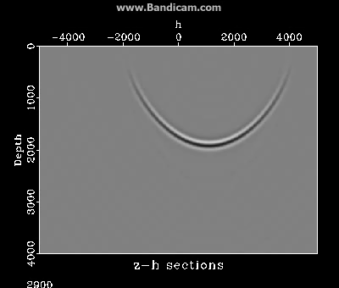
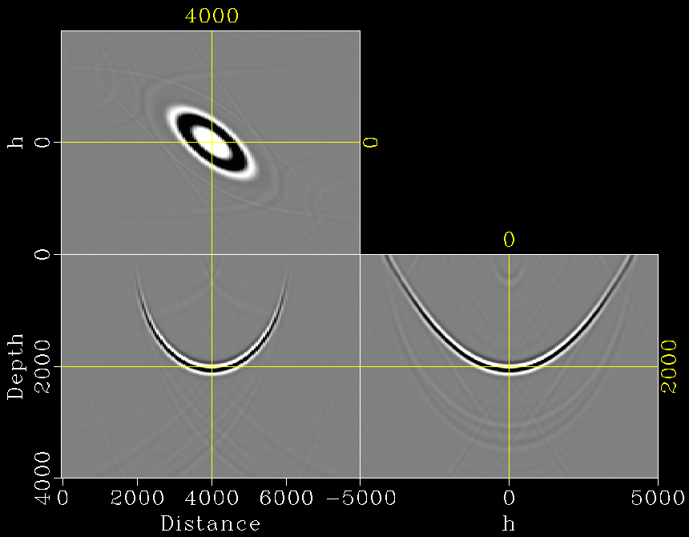
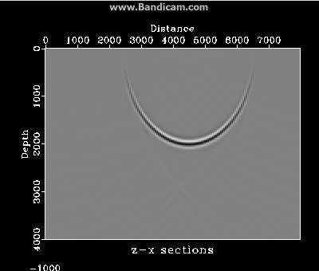
Extended Impulse Response Test (H=0)
Impulse (x=4000m, t=2.0ms, V=2000m/s)
Zero offset: (H=0m)

Slide 19
Extended Impulse Response
h=0
h!=0
H!=0
S
R
S’
S
R’
R
x₀
x₀-h
x₀
h
x
z

Slide 20
Extended Impulse Response
h!=0
Equivalency between h and H:
H!=0
: Semi major axis (a) :
: Semi minor axis (b) :
: Focal point (f) :
: Eccentricity (e) :
R’
S’
S
h
H
R
x
α’
α
z

Slide 21
Extended Impulse Response
Equivalency between h and H:
h!=0
H!=0
Get H response from h response by:
Shift x by: h
Stretch x axis by: 1/S_{x}
Stretch z axis by: S_{z}

Slide 22
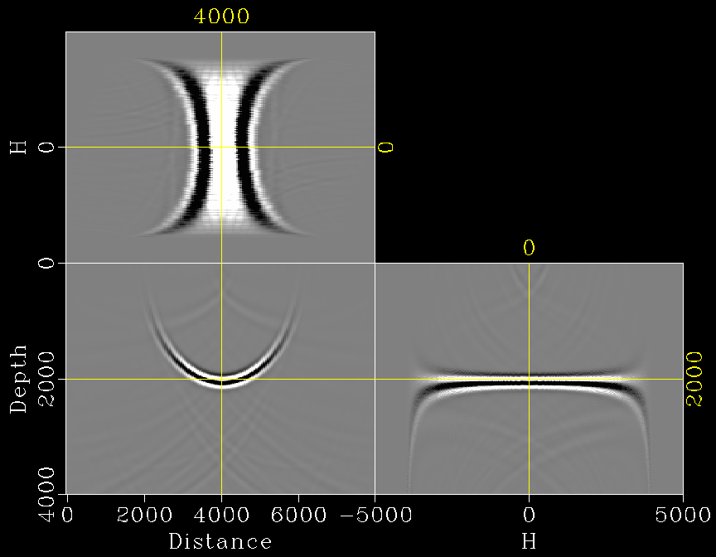
Extended Impulse Response
Equivalency between h and H:
h!=0
H!=0
Extended image by migrating a single trace
Not-extended image by migrating the entire CMP gather
(unfolded over H)

Slide 23
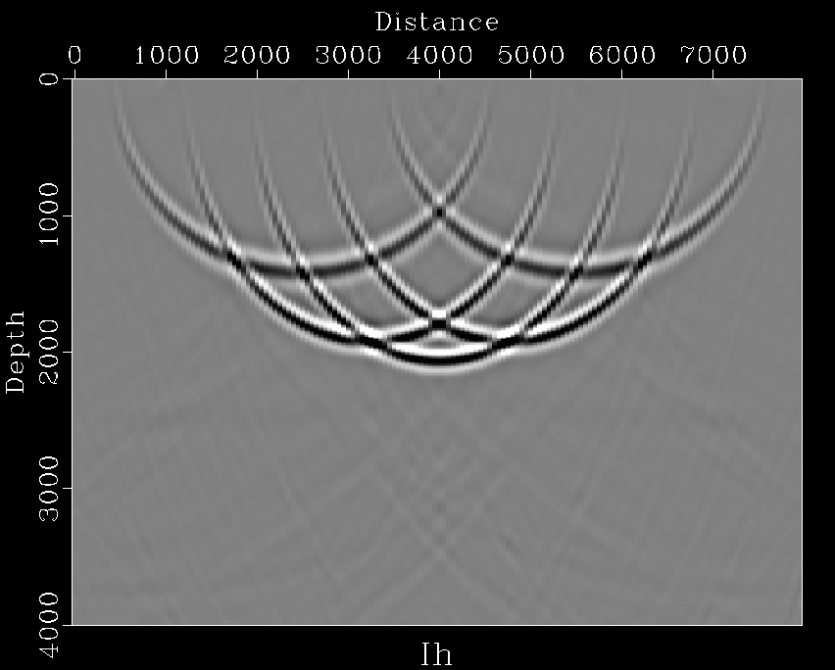
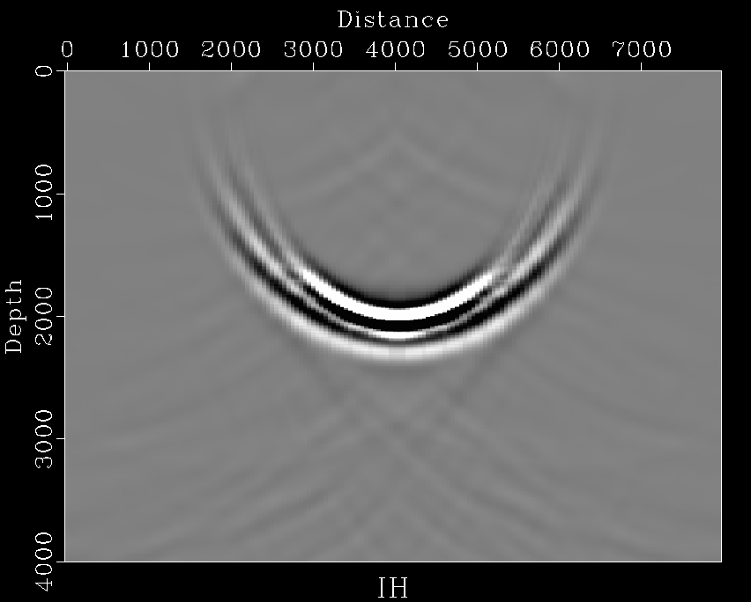


Extended Impulse Response
Equivalency between h and H:
Stack of h
Stack of H
Extended image by migrating a single trace
(stacked over h)
Not-extended image by migrating the entire CMP gather

Slide 24
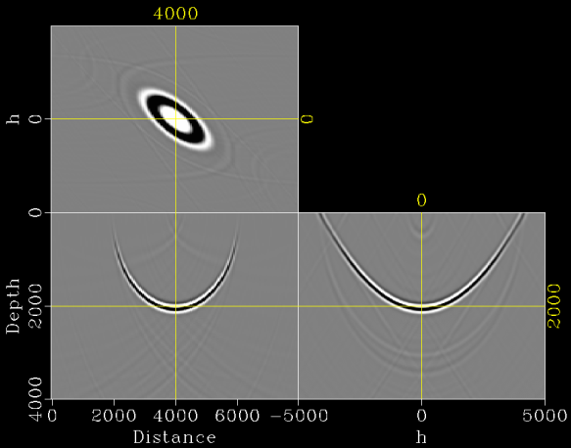
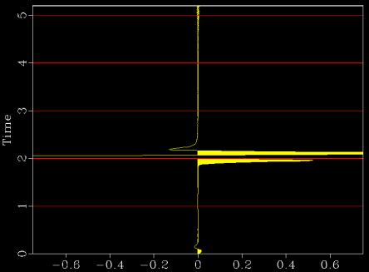
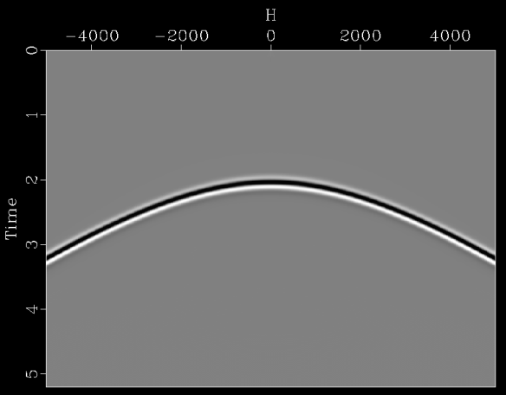
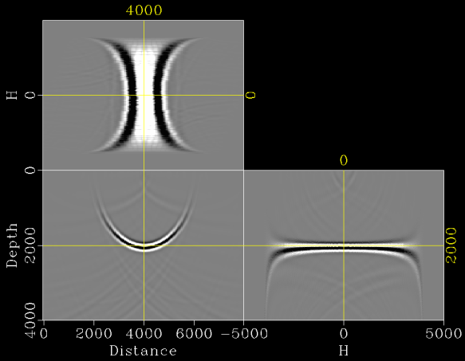
Data Reconstruction
Reconstruct the entire CMP gather from a single trace:
I(z,x,h)
single trace
Extended Imaging
Shift & Stretch
I(z,x,H)
CMP gather
Not-extended Modeling

Slide 25
Extended Image – data accumulation
Single trace is migrated (H=0 impulse response at x=4000m):

Slide 26

Extended Image – data accumulation
Common offset is migrated (H=0):
Migration swings in h
(constructively interfered)
Migration swings in x
(destructively interfered)

Slide 27

Extended Image – data accumulation
The entire data is migrated:
Remnants of migration swings in h

Slide 28

Extended Image – data accumulation
A single shot-gather is migrated (x_{s}=4000m):
Remnants of migration swings in h
Remnants of migration swings in x

Slide 29

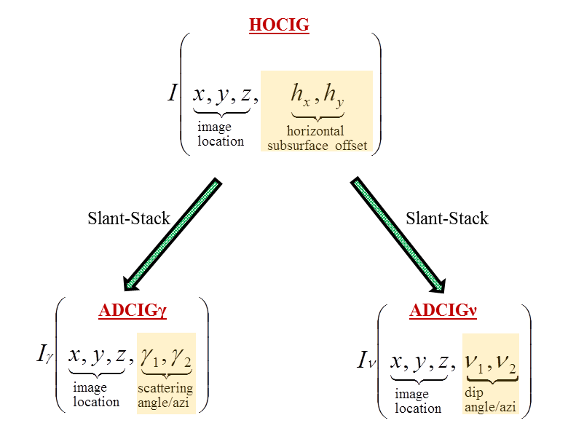
ADCIGs back to angles…

Slide 30
ADCIGγ
Scattering-angle CIG decomposition:
Slant-stack transform in the z-h domain:
Where:
Radial trace transform in the k_{z}-k_{h} domain:
    Where:
h
x
Z

Slide 31
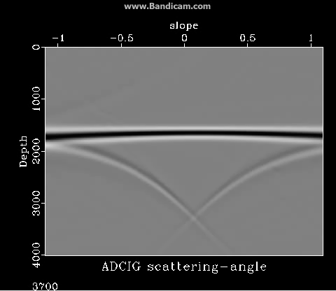
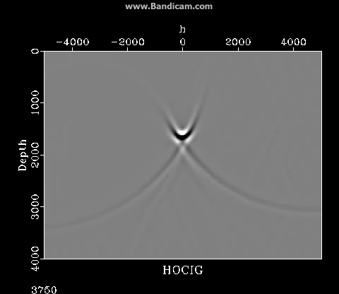
ADCIGγ
CIG
2000[m]
-5 ̊

Slide 32
ADCIGν
Dip-angle CIG decomposition:
Slant-stack transform in the z-x domain:
Where:
Radial trace transform in the k_{z}-k_{x} domain:
    Where:
h
x
Z

Slide 33
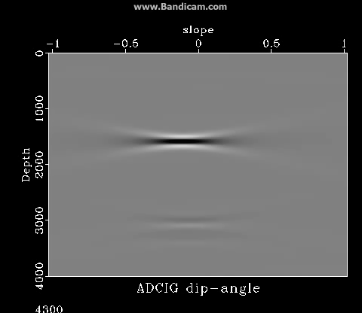
ADCIGν
CIG
-5 ̊
-0.1
2000[m]

Slide 34
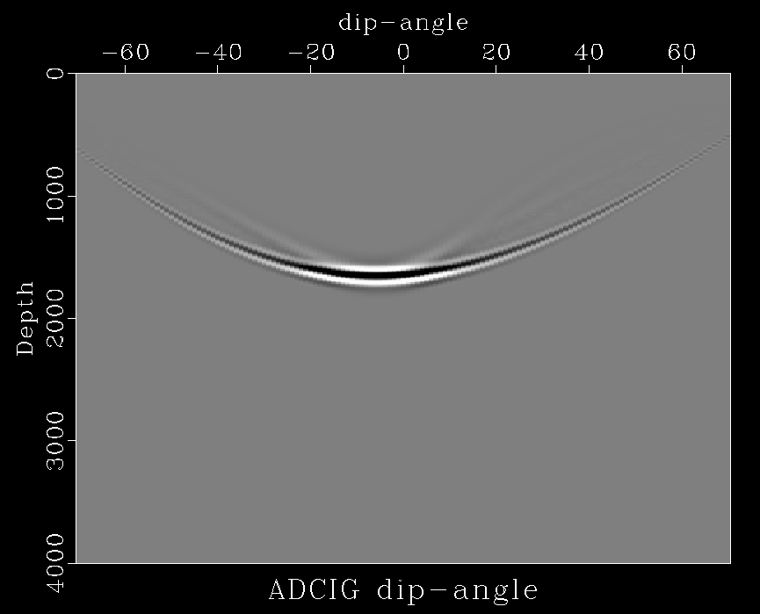
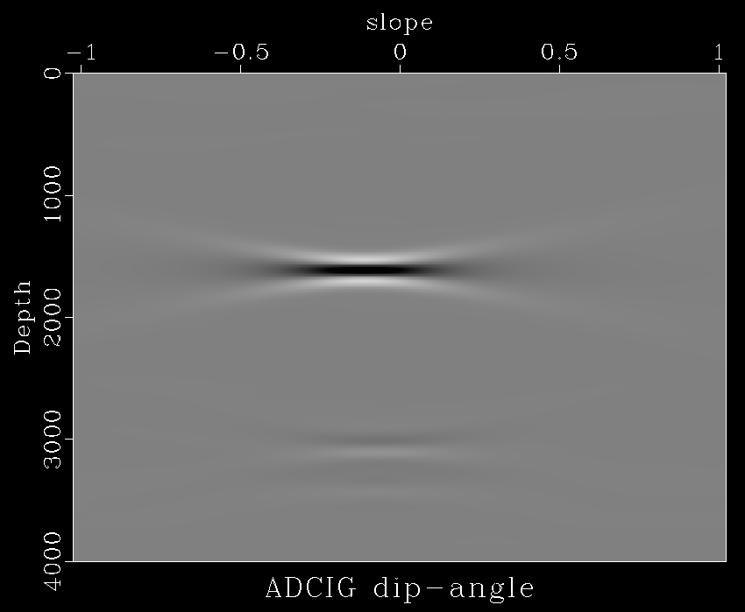
ADCIGν
Comparison:
Kirchhoff-based
Wave-equation-based
-5º
-0.1
Equivalent structural information (the tangent point).
Where did the response tails disappeare?
What happens while using wrong velocity?

Slide 35
Future Study
Wave-equation ADCIGs:
Study the image response in the ADCIGν.
Improve ADCIGγ quality by incorporating structural information from the ADCIGν.
Analyze the image response by using erroneous velocity.
Analyze seismic diffractions in the dip-domain.
Decompose ADCIGs from the vertical subsurface offset (VOCIGs).

Slide 36
Conclusions
Angular image extensions – the ultimate extensions?
The importance of the migration dip information.
HOCIG – leaking to non-physical offsets.
ADCIGγ – slant-stack transform in z-h domain (or radial trace transform in Fourier domain).
ADCIGν – slant-stack transform in z-x domain (or radial trace transform in Fourier domain).
Many observations, but still not too many answers…

Slide 37
Acknowledgments:
Shell for sponsoring my research.
The Israel Science Foundation for partial financial support.
Thank you!

