Slide 1
ExtendED FWI
In the Common Offset, Plane wave, and Shot Domains:
Case studies on OBS and towed streamer data
Papia Nandi-Dimitrova, William W. Symes & John Etgen
Notes:
I’d like to present some initial results and an outline of research we intend to conduct over the next year to investigate extended full waveform inversion (FWI) called EFWI.

Slide 2
Papia Nandi-Dimitrova
3rd year PhD student – Earth Science
10 years as a Geophysicist in Oil and Gas
M.S. Geophysics, University of Wyoming, 2005
B.S. Computer Science, University of Illinois Urbana-Champaign, 2002
B.S. Finance, University of Illinois Urbana-Champaign, 1997
Notes:
I’m a 3rd year student in Earth Science with Dr. Symes as my advisor. My background is initially in business, specializing in investments and venture capital. I returned to school to complete another bachelors in Computer Science, where I specialized in data visualization and virtual reality, spending the end of my senior year at NCSA. It was a natural extension to go into geophysics as an application of this technology and I spent a year as a post-baccalaureate fellow in geophysics and geomechanics at the Lawrence Berkeley National Lab before heading to the University of Wyoming for a masters degree. I wrote one of the first papers in seismic oceanography, a topic that seems to be getting more topical recently. After graduation, I spent 10 years in the oil industry, as an interpreter, a processor and working in Seismic Imaging mostly with BP, who funded my doctoral study for the last 3 years and then laid me off in February. Now I’m a full-time student at Rice and am hoping to graduate before I run out of money – sometime next year.

Slide 3
Extended FWI (EFWI)
Used for velocity estimation
Utilizes an additional dimension of a velocity model
Can circumvent what leads failure in FWI
Notes:
Our group studies Extended full waveform inversion, a variant of full waveform inversion. Our goal is to try and estimate acoustic velocities in the subsurface. The accuracy of these velocities are absolutely key to the quality of the seismic image. In simple geology, getting it wrong will just give you the wrong depths and structure. In complex geology such as in subsalt environments, errors in the velocity model can destroy your image completely. FWI can suffer from a local minimum problem, where if your initial guess isn’t close to the real answer, then you get the wrong velocities out of inversion. Our group uses an additional dimension that is usually stacked over and not utilized to try and circumvent some of the problems that lead to pitfalls with FWI.

Slide 4
Proposed Research
Connects several different variants of EFWI
Uses field data
Provides a catalog of different experiments on the same data
Introduces a new formulation for EFWI
Notes:
There are several different dimensions that have been explored – shot domain, subsurface offset, plane waves. Lots of these studies have been conducted in the past – and some of them on field data. But each of these are done in isolation and on different data sets. Each data set can pose some very different problems with coherent noise, multiples, and these require different preprocessing to deal with. For this reason, it’s very difficult to compare results between studies. This research will use the same data to conduct repeated experiments in three domains, the plane-wave domain, shot domain and a new surface common offset domain for two of the most common types of recorded marine data: towed streamer where the boat tows an airgun source and recording instruments behind it, and Ocean Bottom Seismic or OBS, where the recording instruments are located on the sea floor.

Slide 5
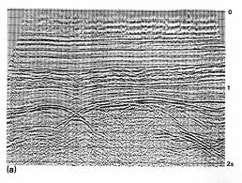


Seismic Imaging
West Virginia U
data ->
collected, or modeled
velocity model ->
estimated
image ->
migrated
Notes:
Seismic imaging is the process of creating an image from recorded data of the subsurface. You can either collect it out in the field or model it in the computer. Raw data should be migrated to convert reflectors from potentially mis-positioned time events to correctly positioned depths. To get to depth, you need a velocity model, or an understanding or guess of how fast acoustic waves travel through the rocks as they propagated from the source and were recorded as data. How well you make your estimate of your velocity model greatly effects what you get out in a final image. To get an image in depth, you use a process called migration, of which there are several types including Kirchhoff, which uses a ray-based approximation that says the waves that travel from the source to the receiver can be approximated by one single line. This assumption can have problems in complex environments like below salt or where there are sudden and large differences in lateral velocities. Another type is Reverse Time migration or RTM for short. This is a wave-equation based algorithm which models a proper wavefield from the source in the computer and multiplies it in the frequency domain with backwards propagated data that was recorded at the receiver, and where they meet, an image appears.

Slide 6

Seismic Inversion
West Virginia U
data -> d
modify m
starting velocity
model -> m
final velocity
model
Notes:
Seismic inversion, which is what we do, is the process of trying to get a velocity model that would make the data that you recorded by repeated guesses. You start with an initial guess of the velocity model, m, that you can get by constructing it from well logs, semblance analysis or travel-time tomography, or even a homogenous starting model. Then
you propagate a wave through it in the computer by forward modeling, F. This synthetic data is F[m] and then you compare it to the data that was recorded, d in a least squares sense. If you do a terrible job guessing the velocity model, then the difference between F[m] and d is large, and then you go back and modify the velocity model to get it closer to the right answer. The minimizing of this equation iteratively is FWI.

Slide 7
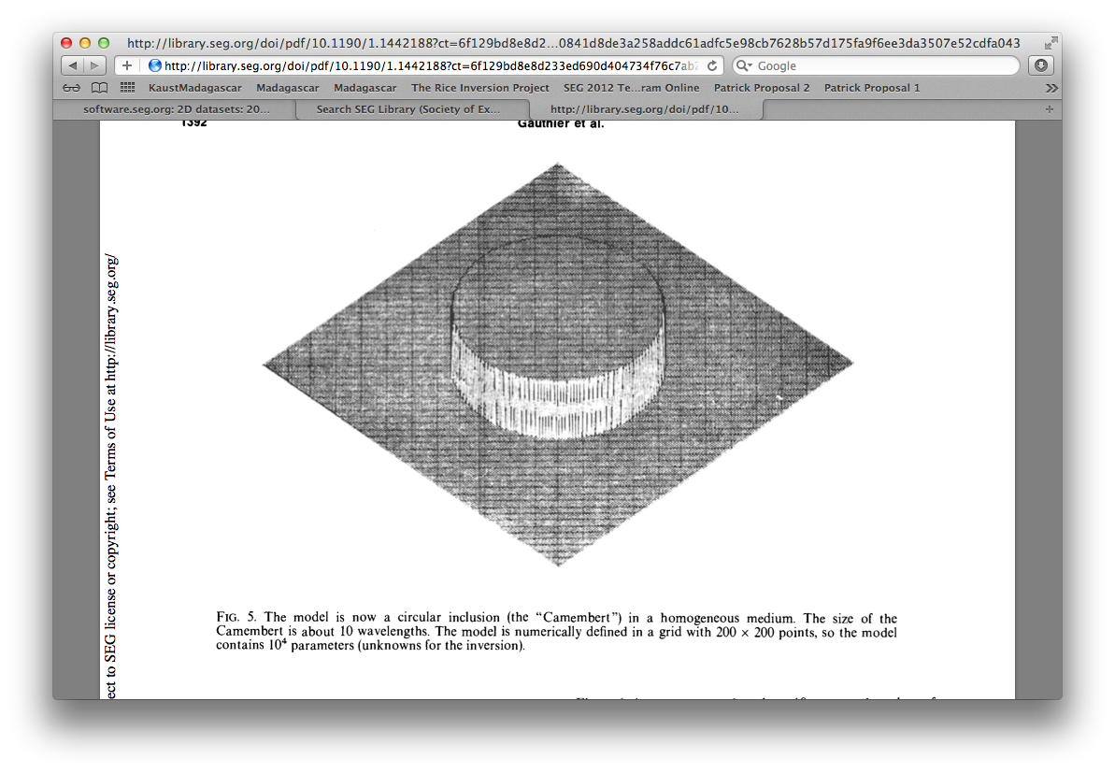
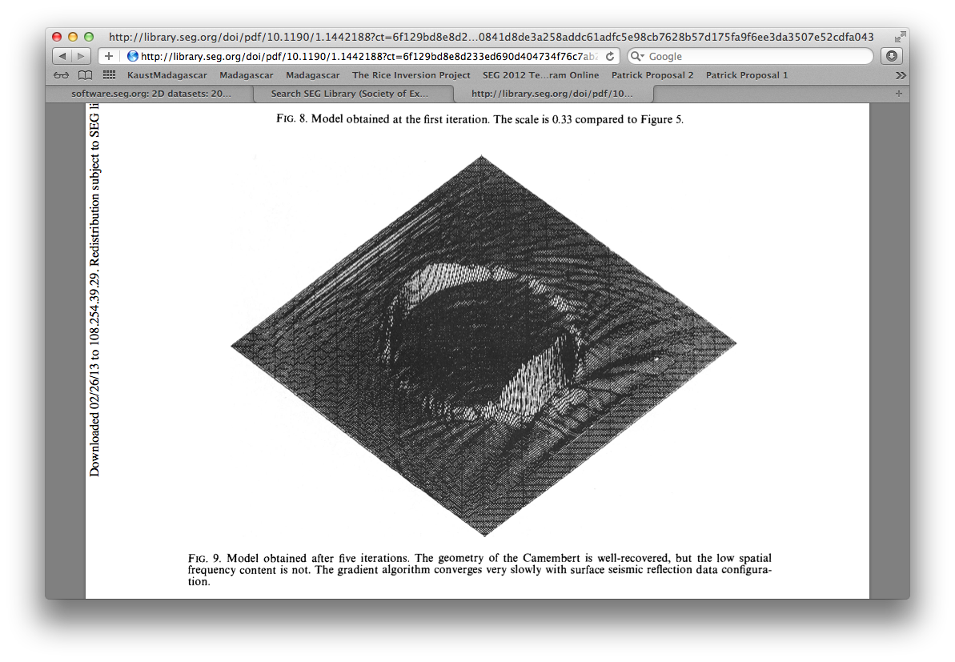
FWI: Long and short λ scales
Gauthier, et al. 1986
True
Inverted
Notes:
The problem with FWI is that it has a hard time finding long wavelength information from the data. One of the first studies to recognize this used a model of a cylinder and propagated some waves through it to obtain synthetic data. Then they tried to invert the data to get the original model out and found that the reconstruction was lacking a certain feature. The inversion successfully recovered the edges of the model. This corresponds to the short wavelength reflectivity of the velocity model. However it failed to obtain the basic shape, the volume that makes it a cylinder, which corresponds to the long wavelength information.

Slide 8
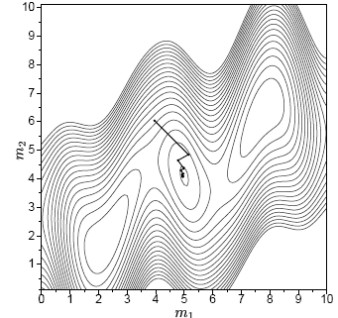
FWI: The local minimum problem
Sirgue, 2003
Notes:
This is why, with FWI, that you have to already know the long wavelength background velocity of the model – the inversion isn’t going to recover it for you. Laurent Sirgue illustrates this concept beautifully in these contour plots of the solution space. The black line represents the path taken by the inversion to get to the answer, and there are three bullseyes in the solution space, each representing a solution. However the biggest central bullseye is the best solution that explains the entire solution space. He shows that if you start your inversion next to one of the smaller bullseyes, which are called local minima, that the inversion will iterate to give you the answer that is best only in that local area. And that you have to start your inversion very close to the best solution, called the global minimum in order to get to the solution that explains all of the data, rather than most of the data.

Slide 9
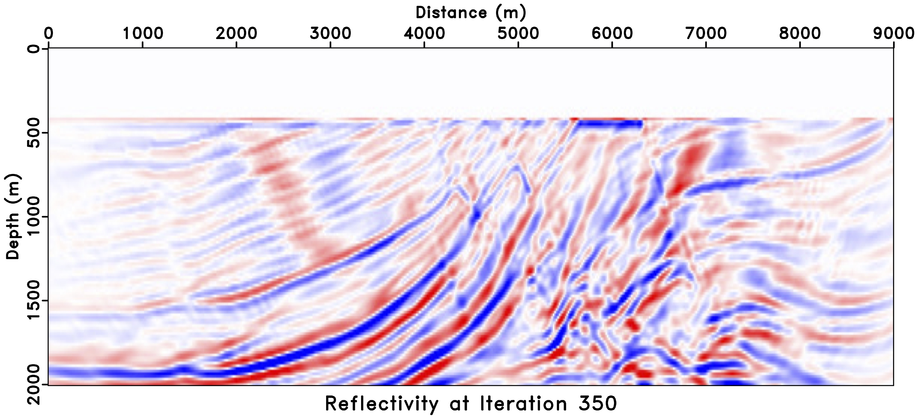
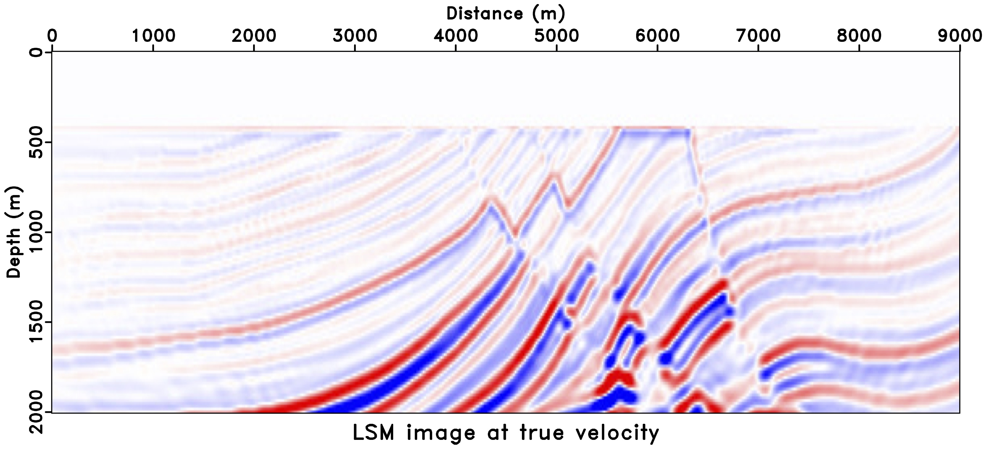
The Local Minimum Problem
Yin Huang, 2015
Notes:
So how bad can a local minimum be? Yin Huang has a fantastic and very powerful example where she has taken a synthetic model called the Marmousi model which is the model on the bottom. She has used an inversion algorithm called least-squares migration to try and fit the data. LSM is like a baby version of FWI where it only tries to fit the short-wave length reflectivity of the model and uses a linearization to approximate the relationship between the model and the recorded data. The top is her result and it fits 95% of the recorded data. Now if you fit 95% of the recorded data in the field, you’d call yourself a hero and be done with it. But in this case, because the experiment is synthetic, we know the right answer. The result she obtained has very large undulations everywhere in the model going from slow to fast velocities and adding a great deal of complexity in the model in the attempt to fit the data. These undulations in the velocity model will end up repositioning the reflectors in the seismic image in the wrong places putting hills and crevices everywhere. Imagine if this were field data and you didn’t know that your result was filled with errors.

Slide 10
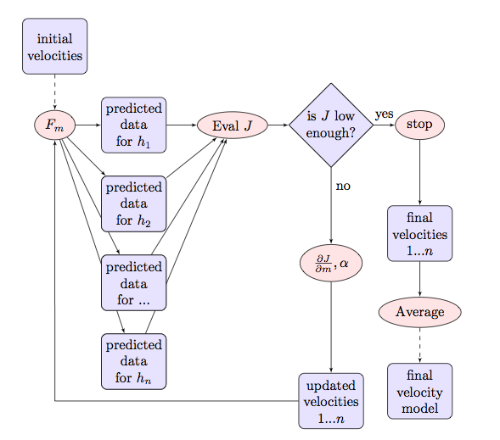
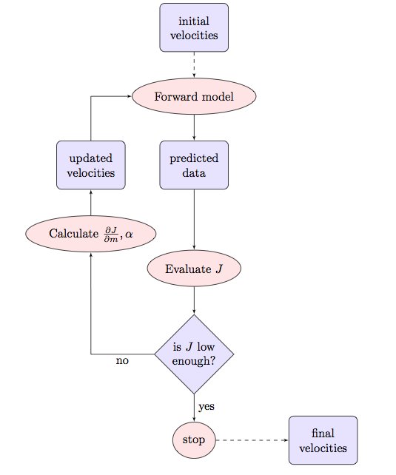
EFWI versus FWI
FWI
EFWI
Notes:
Our group tries to circumvent this problem by using extended models – kind of like unstacked velocities. We look in an additional dimension that is normally not looked at in FWI, in order to recover the long wavelength portion of the background model that is hidden to FWI and causes it to hone in on a local minimum. In FWI, you try and recover one velocity model that predicts the data you record. In EFWI, there is an explicit scale separation between long and short wavelength velocities. You recover the short wavelength velocities in the same way that LSM and FWI does using the F[m] –d least-squares minimization that I showed you back when everybody was awake. But then we use a velocity model that varies along an additional dimension – a neighboring shot for example for shot domain extended FWI and compare between them. Because the long wavelength portion of the velocity model is not going to change from one neighboring shot to the next – it’s long wavelength. We have a velocity model for each shot, or each offset or each plane wave (h1, h2, …hn) and then we try and minimze the difference between each of them to zero. Once they’re all the same, we just stack them at the end – which you can do because they’re all the same, and you get one velocity model.

Slide 11
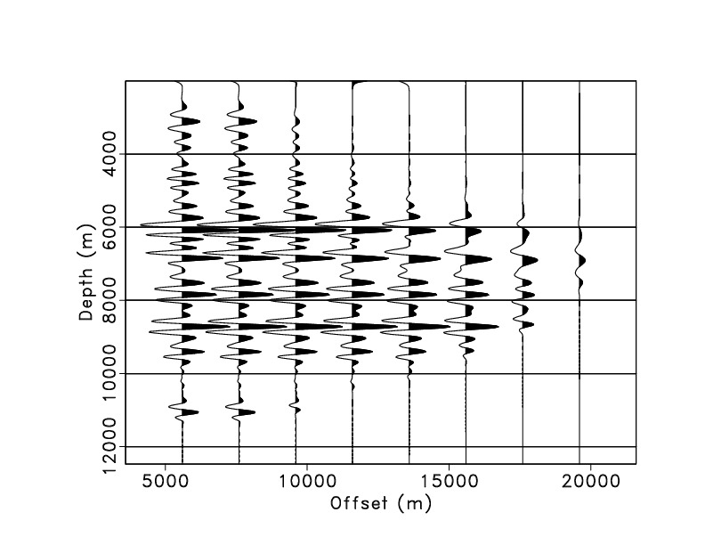
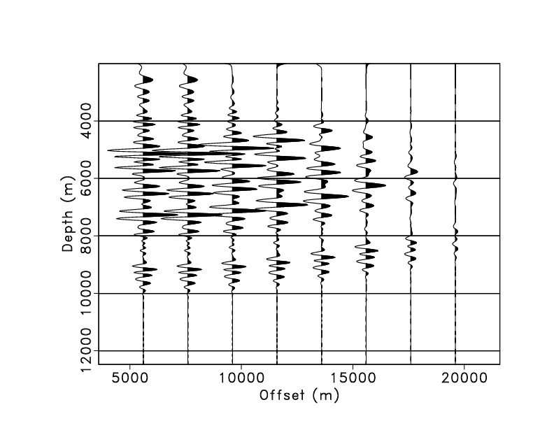
EFWI: The Extended Domain
Notes:
In the extended domain, here’s an example on synthetic data of how it works. On the left is a trace with some reflectivity on it and all the reflectors line up as you go across the horizontal axis, which is the extended axis – here in the offset domain. If they all line up, then the background velocities are also the same. On the right, the background long wavelength velocities are changing and as you go from one offset to its neighbor, you see moveout. This would indicate to the inversion that there is an error in the background velocity model and it modifies it accordingly. But if you stacked all of these traces together, and didn’t have an extended model like in FWI, there would be no way to tell if the background velocity was ok or not, and you’d have to just assume that it was.

Slide 12
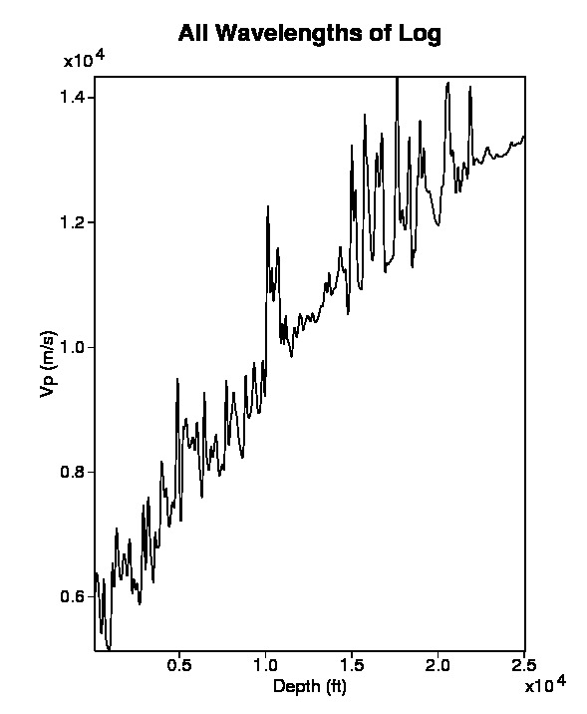
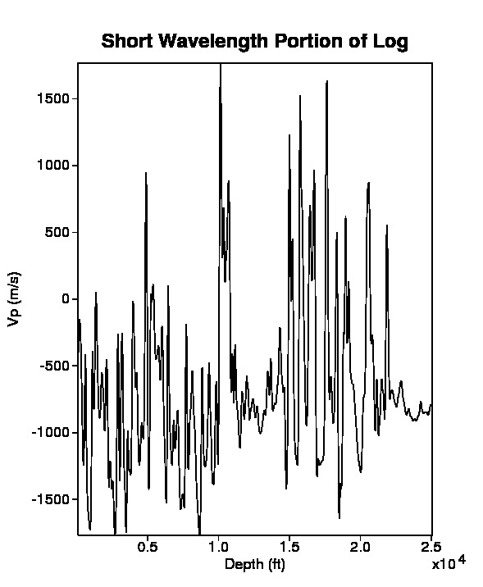
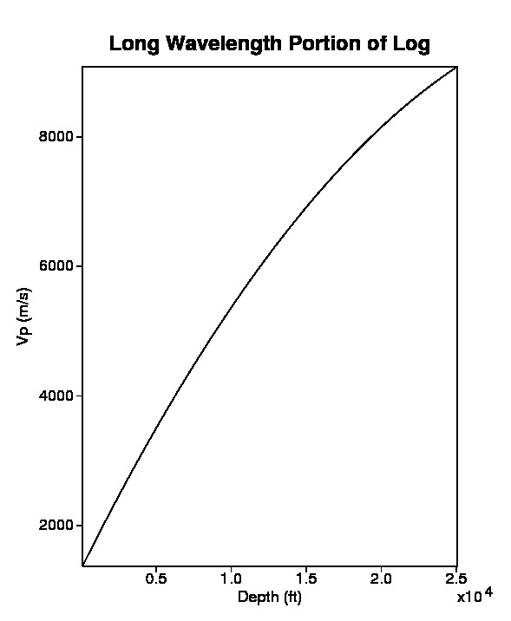
EFWI: Separation of Scales
Notes:
EFWI relies on the separation of scales in the velocity model, which is a little hard to visualize, so let me show an example using a well log. The left-most image is something you might collect out in the field. Depth is increasing on the horizontal axis and velocity is increasing with depth. This well log has two parts to it. The rightmost image shows the background velocity to the trend. It follows a smooth path and averages what the well log is doing. There are no oscilations and in the background model, there is no reflectivity. The middle image is the reflectivity or short wavelength part of the velocity model. It is the oscillatory part. If it were synthetic data, and I was a better processor, there would be no background trend to it – it would be wiggling centered around 0. However there still seems to be a little left over. The left most model is the total velocity model, m. It is the sum of delta m, or r for reflecitivity and m_l which is the long wavelength portion of the velocity model. I will be using both delta m and r to describe the middle picture during this presentation.

Slide 13
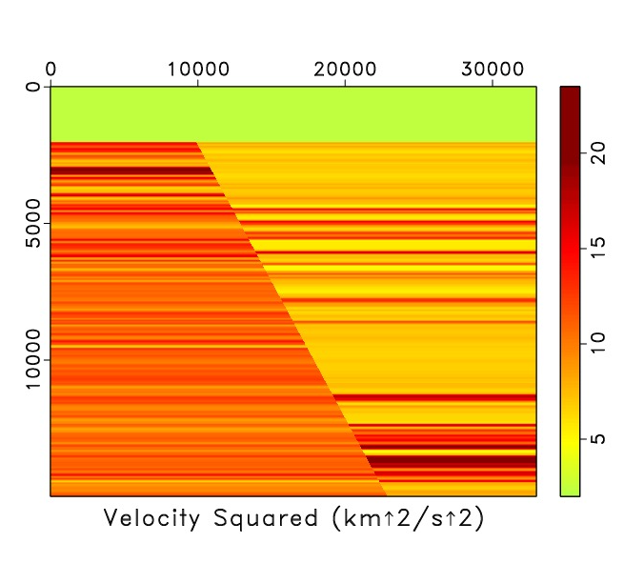
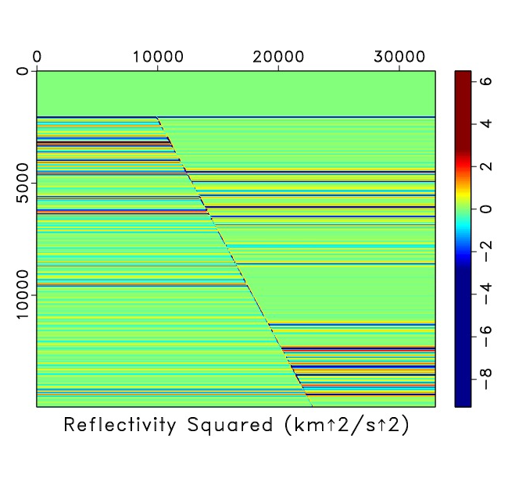
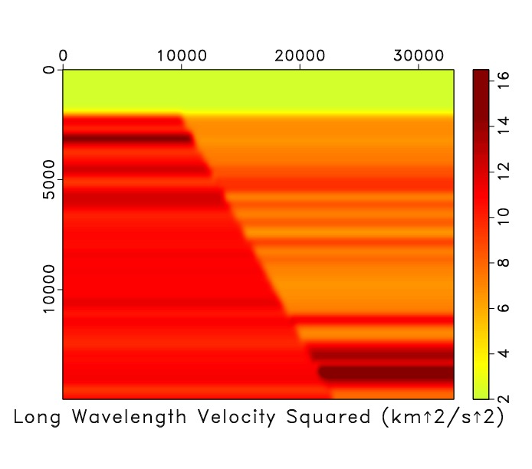
EFWI: Separation of Scales
Notes:
To move from a 1D example to 2 dimensions, here is the same thing using a synthetic velocity model made from that same log file. The leftmost model, m is what you get if you added the reflectivity and the background model together. The background model has some oscillations, but not enough to create any reflections. It’s been smoothed.

Slide 14
EFWI: Two loops
Fit
Fit
modify
modify
Notes:
EFWI is executed in two different loops in order to fit each of these wavelength scales separately. The inner loop fits only the reflectivity – like least squares migration. Once this is fit, the velocity model can successfully predict the data to below some small error threshold and we set F[m] –d = 0. Then the outer loop fits the background model by looking at the velocities in the extended domain – across shots or plane waves or offset.

Slide 15
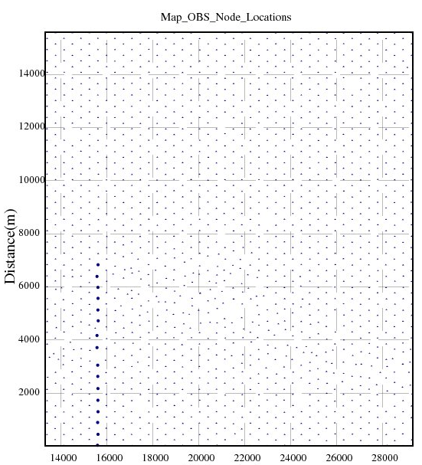
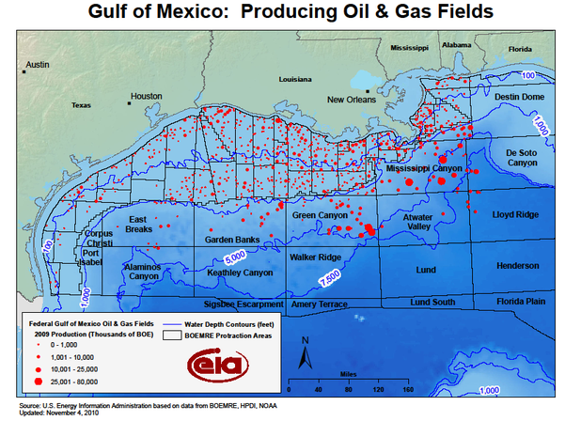
Study Area (1) – OBS Nodes
data source: BP & BHP Billiton
Notes:
We intend to use EFWI for a producing oil field in the Gulf of Mexico that uses recording devices or nodes located on the ocean floor. Sources come from a ship towing an airgun source. We selected a nodes from a 2D line in an uncomplicated part of the field, and used only the sources which also fell into this 2D line. These OBS nodes are large compared to receivers that are towed behind a boat, are expensive and are laid out and collected with a remote operated vehicle (ROV). The sources are not expensive to shoot, and many of them are shot off across the entire survey while each is recorded by every single node. Compared to nodes, there are many more shots. This turns out to be important for EFWI.

Slide 16
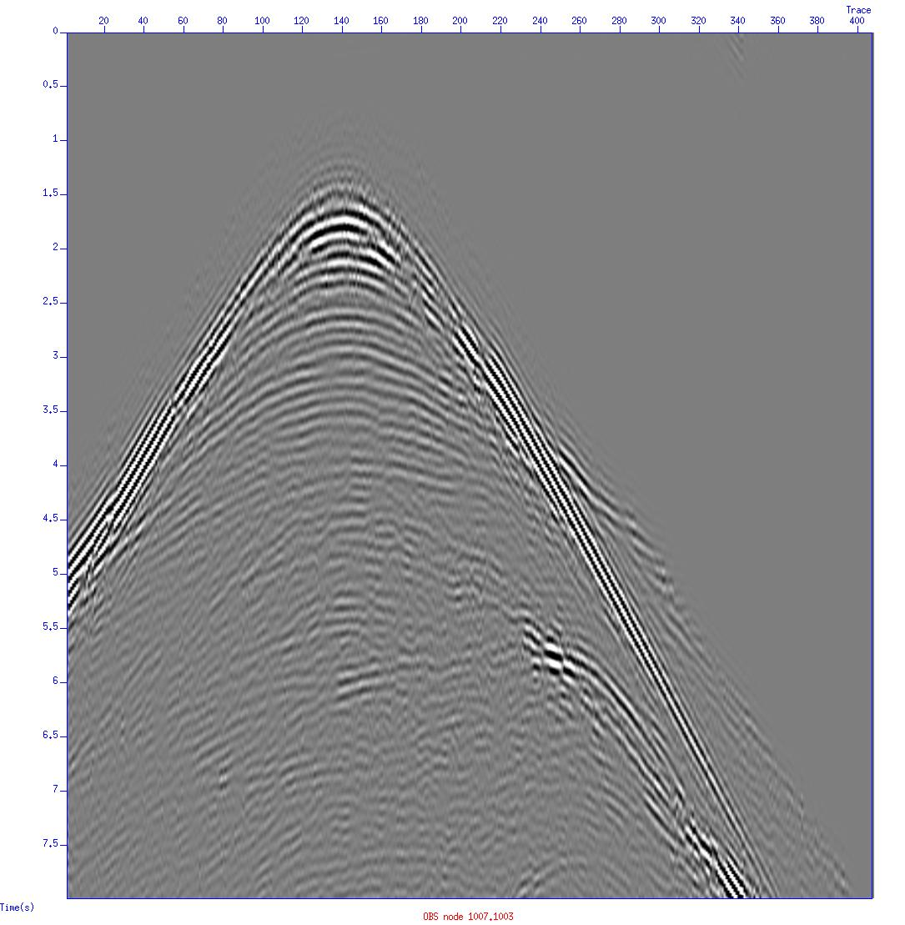
Ocean Bottom Seismometer (OBS) Data
Node 1007.1003
Collected data
Notes:
Recorded data from one OBS node looks like this. The horizontal axis is distance, and the node is physically located at the top of the apex. The space above where the reflections start is the water column and then you see the first reflection from the water bottom recorded in the data. All the traces from the shots along this 2D line are recorded here – this is called a shot gather.

Slide 17
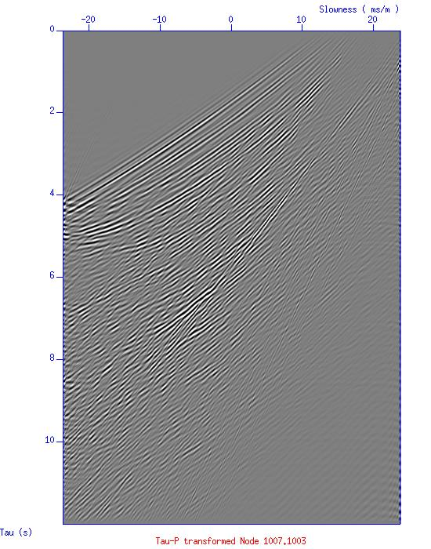
Plane wave domain
radon transform --->
Notes:
A plane wave is a wave that moves like a line. If you drop a pebble in the water, the wavefronts that emanate from it are circular. But if you move far enough away from where the pebble was dropped, you can begin to approximate the wavefront with a line. We can create a plane wave by using a radon transform. If you take an image and sum along a hyperbola, it’s a hyperbolic radon transform. Here we use a linear radon transform and sum along a plane. When you do this, the node is transformed into slowness (opposite of velocity) shown on the horizontal axis, and to intercept time, or what time that linear plane would hit 0, on the vertical axis.

Slide 18
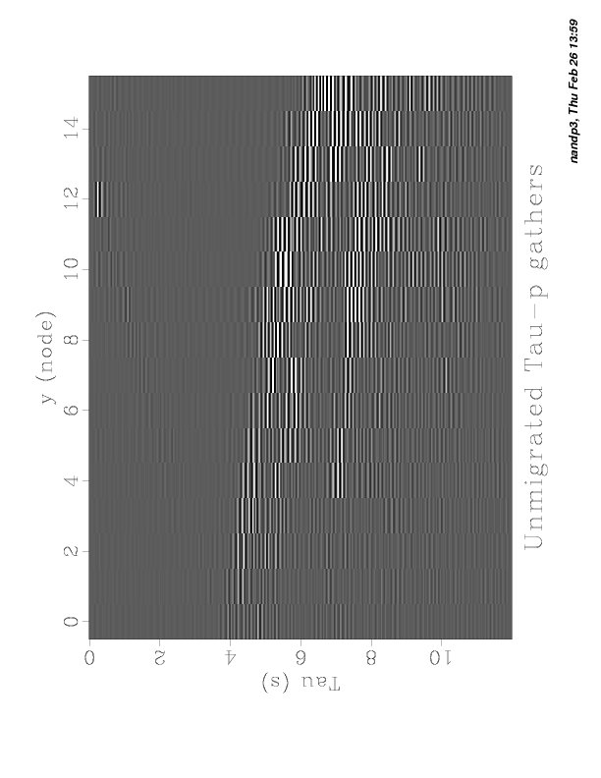
Extended Plane Wave Domain
Node
node 16
node 3
node 2
node 1
Notes:
If I radon transformed each of the 16 nodes in my 2D line and took a line through all of them at a single slowness value, it would look like the image on the right. This is an unmigrated version of what data in the extended domain would look like to EFWI. Each trace has been horizontally stretched because there are only 16 of them – one for each node. The resolution in the extended domain is directly related to the number of nodes. Since we care about the background velocity model, which is long wavelength, this is ok. But we will probably only be able to use the reflectors which aren’t aliased in this direction. Synthetic studies have indicated that if the extended domain is very aliased, it will no longer have a global minimum. Note that we are looking at an image – and EFWI inverts velocities. These are not one to one – however we can still make some observations about sparcity and likely outcomes.

Slide 19
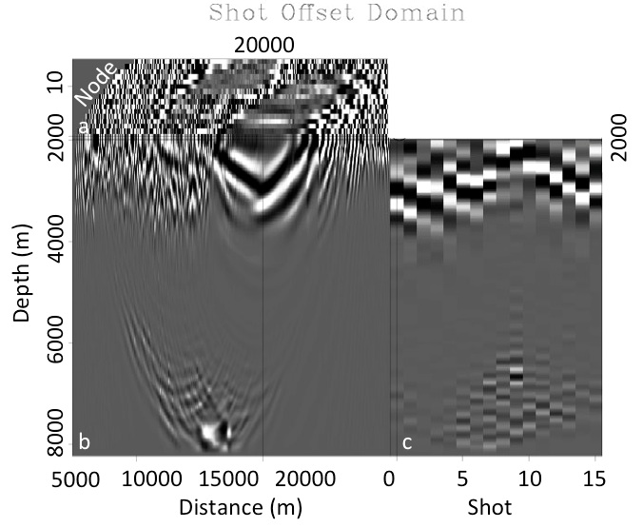
Extended Shot Domain
shots
nodes
Notes:
What if we looked in the shot domain? On the left is the data recorded in the OBS from before, except now I will invoke reciprocity and switch the shots and receivers because the wavefield is the same if it comes from either direction. I do this to because it’s much easier to migrate 16 shots (the number of nodes) than it is to migrate 407 shots (the number of actual shots). Then in box b on the right image, I have one migrated node. I can tell where it is located based on where the wavefront eminates and can see some deep reflecting events. In box a, I see the top of the migrated images for all shots as they move across the survey. The black line splitting box b into a right and left half is one distance value ~17000 m. If I take that single distance value and look across all of the shots, I get box c. The reflectors that you can see if box c is also very horizontally stretched. Most of the bottom reflectors are aliased, and it’s hard to see signal. We have the same issue with sparcity that we did with plane waves.

Slide 20
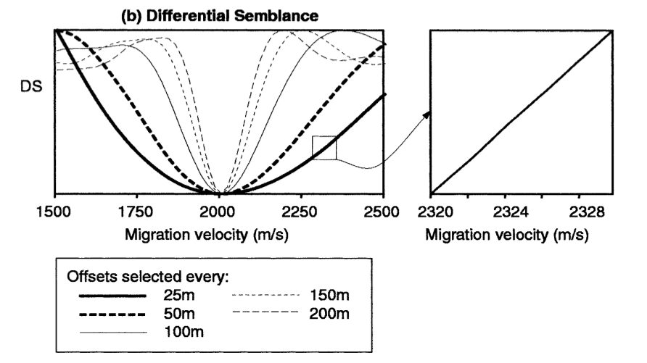
Aliasing in the Extended Domain
Chauris & Noble, 2001
Notes:
If the whole point is to go the extended domain so that we can find a global minimum, then it’s important that the extra domain isn’t aliased. Chauris & Noble used surface offsets in EFWI using a ray-based approximation to the wave equation and found that if you sample offsets too sparsely that you no longer get a global minimum, and you start to get side lobes on your objective function.

Slide 21

Common Offset: Existing Technology
Using the framework:
John Etgen. 3D Wave Equation Kirchhoff Migration. In 2012 SEG Annual Meeting, 2012. Society of Exploration Geophysicists, 2012.
To modify r, calculate:
Notes:
What about the common offset domain? The third domain is surface offset, or the surface distance between the source and receiver location. I say surface because there is such a thing as subsurface offset, and that’s not what I’m talking about here. Surface offset is used in a lot of processing including to find fluid indicators like with AVO or amplitude variation with offset. But it’s really hard to calculate surface offset using a wave-equation based method instead of the a ray-based approximation. One way to do so is using Wave Equation Migration. When I make an initial guess at the velocity model and it isn’t right, I want to modify it. For the short wavelength reflectivity, I do this by calculating a gradient – shown here. (Define Greens function, reflectivity residual, equation)

Slide 22
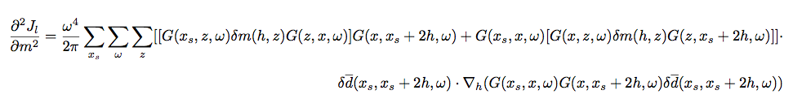
Common Offset: Existing Technology
Using the framework:
John Etgen. 3D Wave Equation Kirchhoff Migration. In 2012 SEG Annual Meeting, 2012. Society of Exploration Geophysicists, 2012.
To modify m_{l}, calculate:
Notes:
But for EFWI, I also need to modify the background velocity model and oops this is not possible. Using the framework for WEK, I need to calculate the Greens function to another subsurface point z from both the source point and the receiver. Everywhere that a z appears, this becomes a really big calculation. BTW the derivation for this equation is beyond the scope of this presentation but will hopefully be coming soon to a theater near you in paper form.

Slide 23
Existing Technology
X_{s}
z
x
Notes:
To update the background velocity model, you have to calculate a greens function from the source to a point in the subsurface z, then to a reflector in the subsurface x, then from the reflector and the subsurface point back to the receiver.

Slide 24
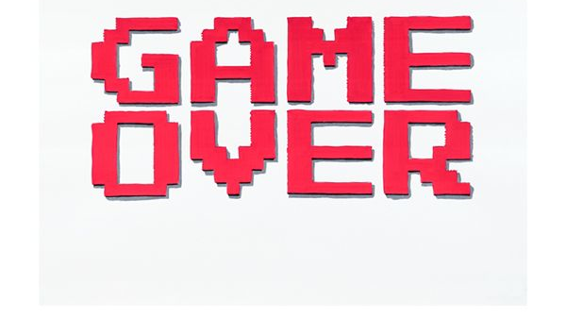
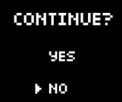
Existing Technology
X_{s}
z
z
z
z
z
z
z
z
z
z
z
x
z
z
Notes:
You have to do this for every single point in the subsurface. This is the same as running FWI, already a super expensive process, for every subsurface point in your model. So what do I do?

Slide 25
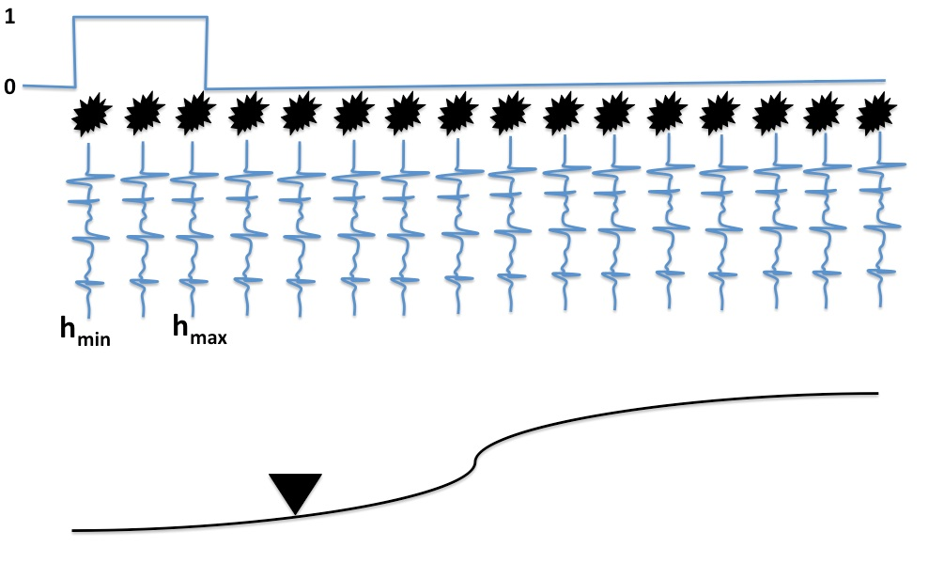
Common Offset RTM (1 shot)
Notes:
John Etgen proposed that I take every shot (which is really a node) and keep parts of it that have a similar offset and group them together. Then I mute all of the other traces and migrate that shot as if most of it were zero. Then I move over the mute and send in the next couple of offsets. This has the effect of averaging those traces together into an offset bin.

Slide 26
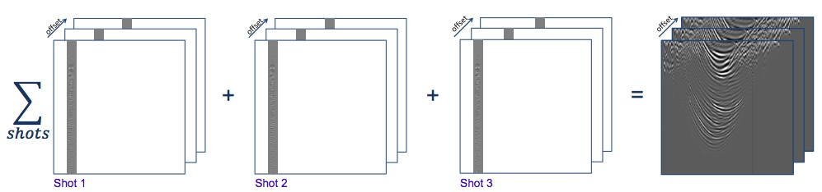
Common Offset RTM (all shots)
Notes:
I do this for every shot and keep the offsets separated. Then I add them up for every single shot and I get a volume at the end which has offset as the extra dimension.

Slide 27

New Technology
Using Common Offset RTM:
To modify r, calculate:
Notes:
I call this algorithm common-offset RTM and here’s how you modify the short wavelength reflectivity. You just add an H for heaviside function which is equal to 1 when you’re inside the range of offsets that you want to migrate, and 0 otherwise. You can use a regular RTM after muting the input.

Slide 28


New Technology
Using Common Offset RTM:
To modify m_{l}, calculate:
Symes & Kern, 1994
Notes:
Now to modify the background velocity model, you use exactly the same gradient calculation as you would for shot-extended FWI. The EFWI doesn’t know it’s really common-offset domain. It just thinks it’s in muted shot domain.

Slide 29
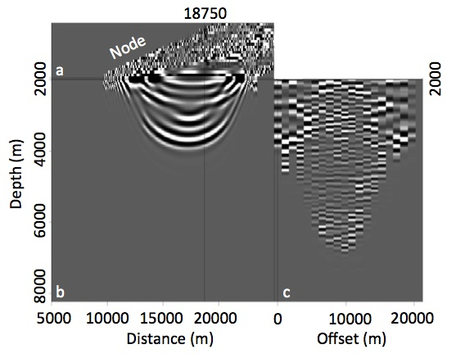
Twenty Offsets
Notes:
The magic behind this method is the flexibility it adds to the extra dimension for EFWI. If I have 400 traces recorded by 16 nodes, and I group them into offset bins containing 20 traces, I would get 20 offset bins in the extended direction. This result looks very similar to that from the plane-wave and the shot-extended domains. The reflectors are present and some are aliased. The long wavelength background model data is still there, but we are limited to lower resolution model updates.

Slide 30
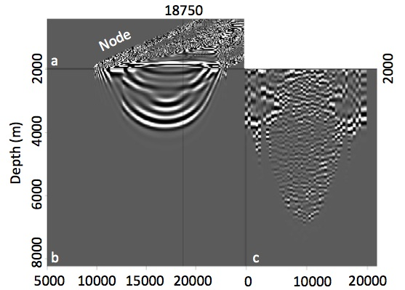
Fifty Offsets
Notes:
I can group 8 traces together and make 50 offsets in the extended domain. Now I am starting to see more subtle features in the data – ones that could help my inversion obtain greater detail in the model update.

Slide 31
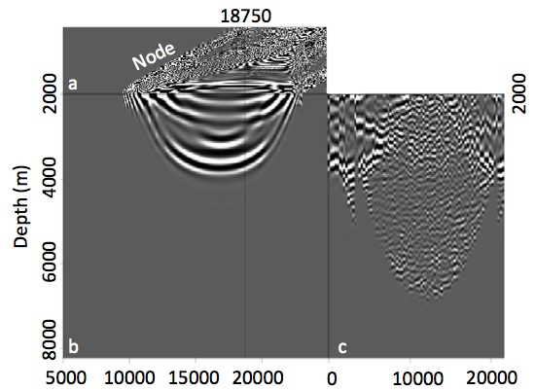
Eighty Offsets
Notes:
Eighty…

Slide 32
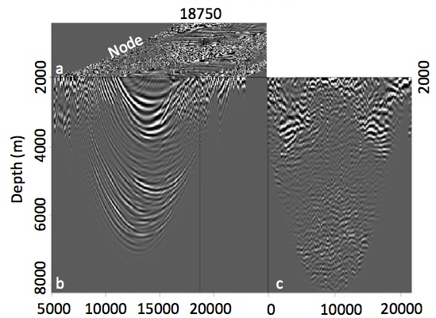
One Hundred Offsets
Notes:
One hundred offsets! I am limited only by the number of traces that I recorded. I could make a bin for every single trace that I have, but there are downsides to this. It would be noisy, and it would take a really really long time to update anything. The cost of EFWI vs FWI depends on the dimensionality of this third dimension. If I have 100 offsets, EFWI is 100 more times expensive than running FWI.

Slide 33
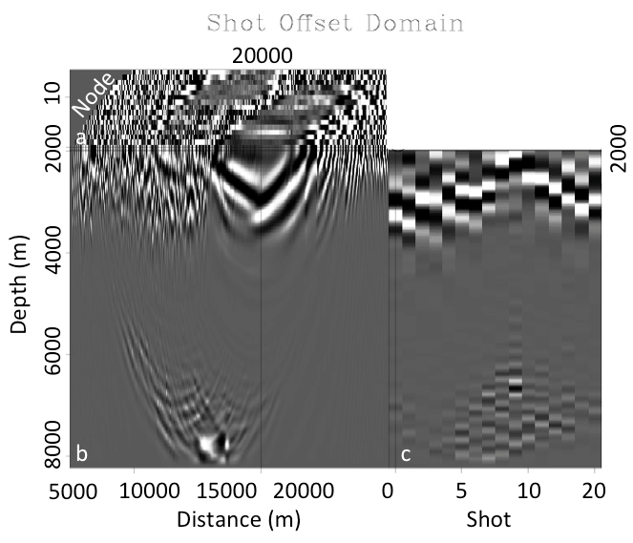
Comparisons
shot
offset
Notes:
Comparing the three, at least for OBS data, because the receiver domain is very sparse compared to the shot domain, EFWI in the offset domain appears to be most likely to give a successful inversion. Next up is the inversion itself. All of these are only results in images, not velocities and other research indicates that its application can be less than straightforward. This is mostly because you have to be able to model all of the wave phenomena present in your recorded data to minimize the error and find the right velocity model. If you can’t model the waves, then you have to remove them from your data – things like coherent noise or multiples in this particular implementation of EFWI. These kinds of processes are not trivial and running EFWI with these three data sets may help shed light on what kind of problems are likely to occur – not just for one study’s implementation, but on the same dataset for several implementations.

Slide 34
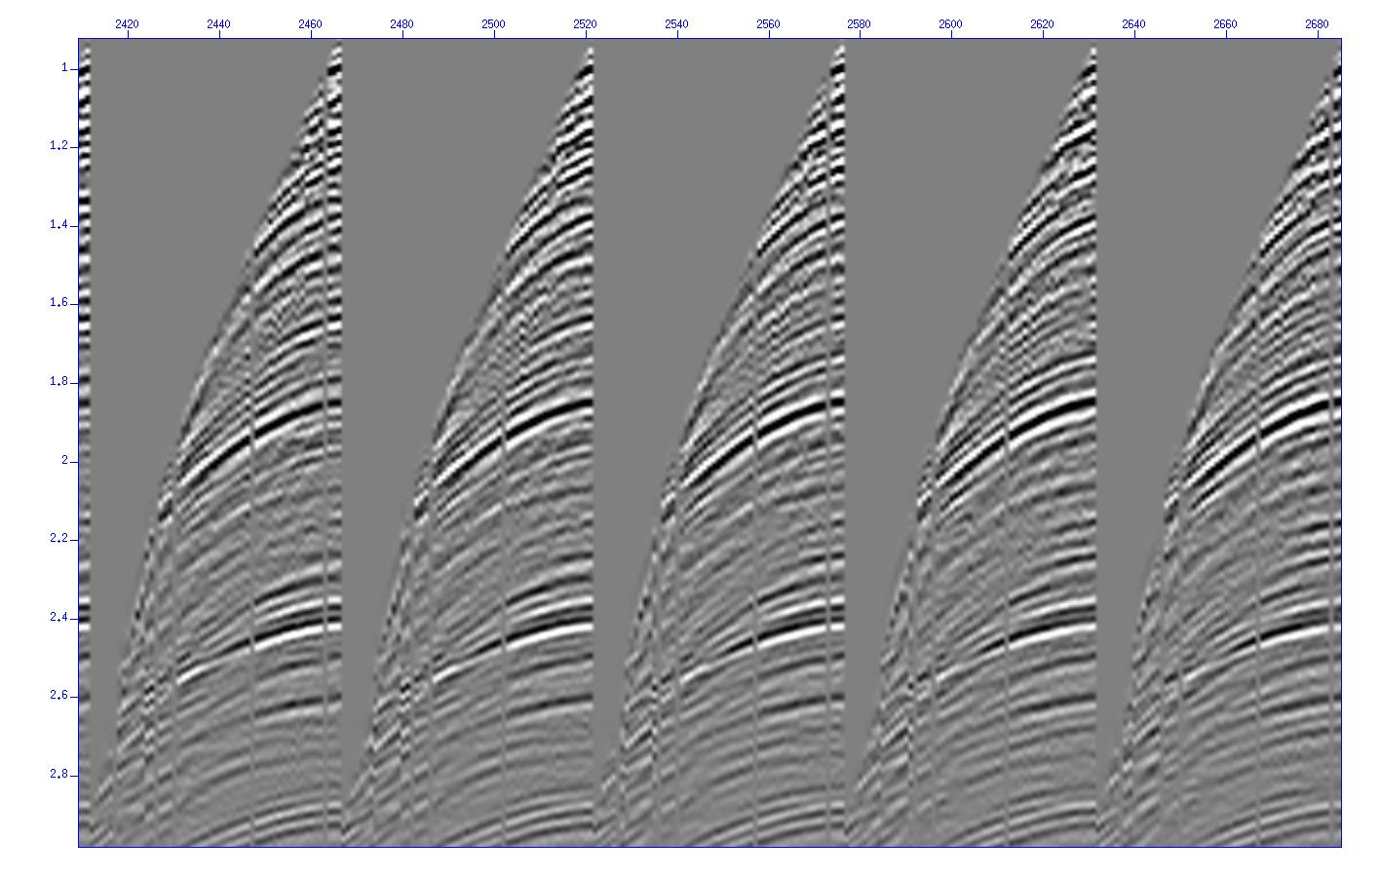
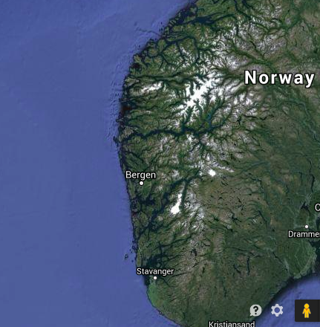
Study Area (2) – Towed Streamer
Notes:
We also intend to implement EFWI on towed streamer data – a type of marine data that is much more prevalent in the industry. The kinds of problems we saw with sparcity will likely not affect the outcome of this study, but differences may largely attributed to computational feasibility and the differences of coherent noise or multiples in each domain.

Slide 35
Conclusions
Migrated data suggest that OBS geometry are more suited EFWI in the common-offset domain
Towed streamer will likely have very different results
To do: migrations and inversion of streamer data in all three domains
Final Result: Definitive comparisons and technique for implementing EFWI on two of the most common types of seismic data

Slide 36
Acknowledgements
BP America, for funding and OBS data
BHP Billiton for OBS data
Exxon Mobil for making the towed streamer data publically available

