Slide 1


Extended Full Waveform Inversion with Common Offset Image Gathers
Papia Nandi-Dimitrova
under the supervision of
William W. Symes

Slide 2
Velocity Estimation
Imaging the subsurface involves many unknowns
Recorded seismic data (d)=
A function of acoustic and elastic parameters of the Earth
FWI= choose m to minimize (F[m]-d)^{T}(F[m]-d)
1
Notes:
As acoustic waves propagate through differing rock types, fluids, stress fields, temperature and pressure regimes, they experience changes in velocity, and can hence provide information about these subsurface properties. The subsequent interpretation of velocities and subsurface images can be used to predict reservoir and hazard characteristics for geoscientists, structural and drilling engineers, and other parties interested in obtaining information about the subsurface. Estimating these velocities is a difficult problem because there are many unknown variables. Yet the accuracy of their estimation plays a large role in the quality of seismic image that can be reconstructed from recorded seismic data. My thesis project seeks to reduce the uncertainties in estimating the speed with which acoustic velocities propagate through an inverse method called FWI. FWI attempts to explain data, d, via a model m of earth structure, the two being connected by a modeling operator F. You compute F[m] by solving partial differential equations. A popular formulation of FWI: choose m to minimize (F[m]-d}^T(F[m]-d). This is a hard nonlinear problem.

Slide 3
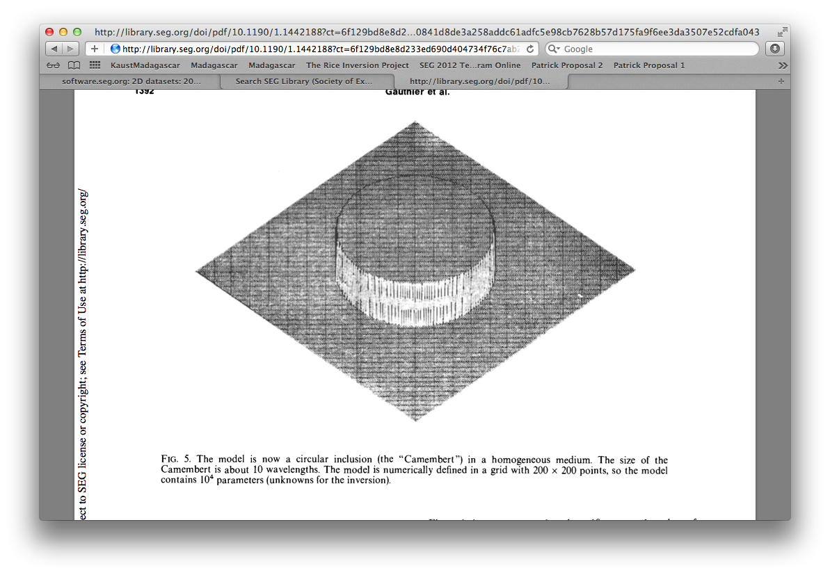
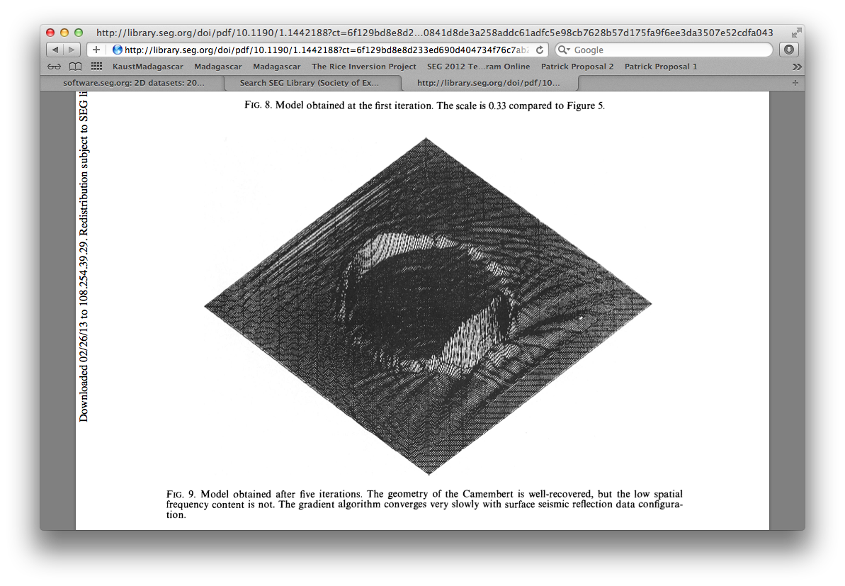
FWI is an ill-posed problem
Challenges for FWI
Gauthier, et al. 1986
true model
inverted result
The low spatial frequency components of the model are hard to recover – they are non-linear to predicted data.
(also known as long wavelength, or background velocity)
2
Notes:
It is hard because many velocity models can fit the data up to some small threshold. Odile Gauthier’s landmark paper illustrates with the inversion of what she called the Camembert model. The true model is a cylinder with a volume and edges that define it. She was able to recover only the edges of the model, which correspond to a short wavelength or reflectivity of the velocity model. She found that the long wavelength or low spatial frequency, represented by the volume of the camembert, hard to recover – because they are non-linear to the predicted data.

Slide 4
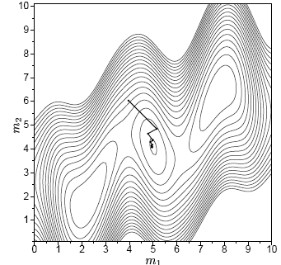
Traditional FWI challenges
FWI is an ill-posed problem
Sirgue, 2003
The low spatial frequency components of the model are hard to recover– they are non-linear to predicted data.
This leads to the existence of many local minima in the solution space
3
Notes:
Without low spatial frequency information, the model given by FWI may be one of several that can predict recorded data to below some threshold, making it the best solution for a local problem. But is may not be the best solution globally. Laurent Sirgue showed a cartoon of the solution space in his thesis that if you start your inversion with a model that is far away from the actual model, that FWI converges to a local solution as shown in the left image, rather than the global solution in the right image had your starting model been sufficiently close to the global solution. Sirgue’s work presented in his thesis and at a workshop represented a step change in velocity estimation from previous attempts, contributing to an increase in FWI for velocity estimation over the last decade or so. To have some hope of solving the problem,

Slide 5
Traditional FWI data input
h₂
A Shot
Gather
h₁
h = offset [1,2,3….n]
A group of one offset = An Offset Gather
4
Notes:
To circumvent this problem, I propose two changes that constitute my unique contribution. First, I will alter the input to FWI from shot gathers to common offset gathers. Some definitions (explain the image). Seismic surveys are large, can be grouped in various ways ("gathers”) I will use offset gathers. Of which there are many.

Slide 6
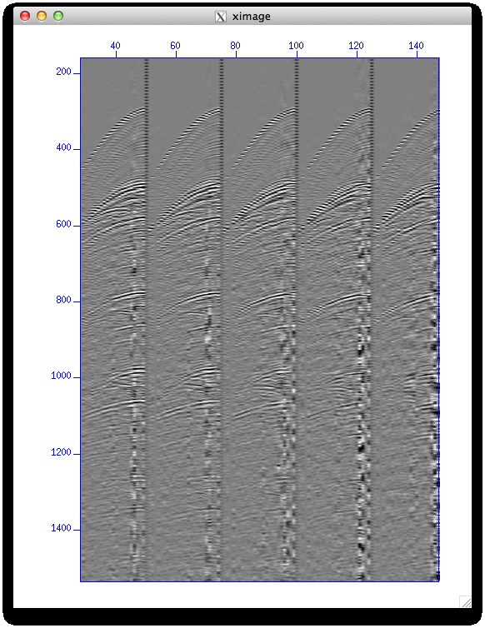
Traditional FWI data input
20
Shot gathers
(Worzel, 1976)
5

Slide 7
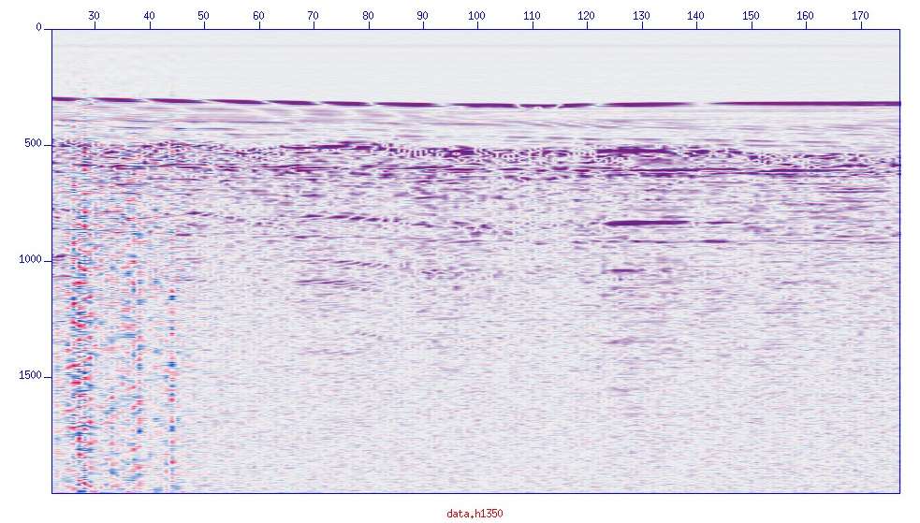
New FWI data input
20
Offset gathers h=1350
(Worzel, 1976)
6
Notes:
For comparison, this is an image of a common offset gather. (explain the image, point out 20 m bar). Each common offset gather is more laterally extensive and hence approximates the subsurface more completely than a shot gather. We expect that this larger sampling will help the inversion converge to a global solution. To include common offset gathers into FWI is a little tricky, and I will use another established imaging technique and incorporate it into the framework of FWI.

Slide 8
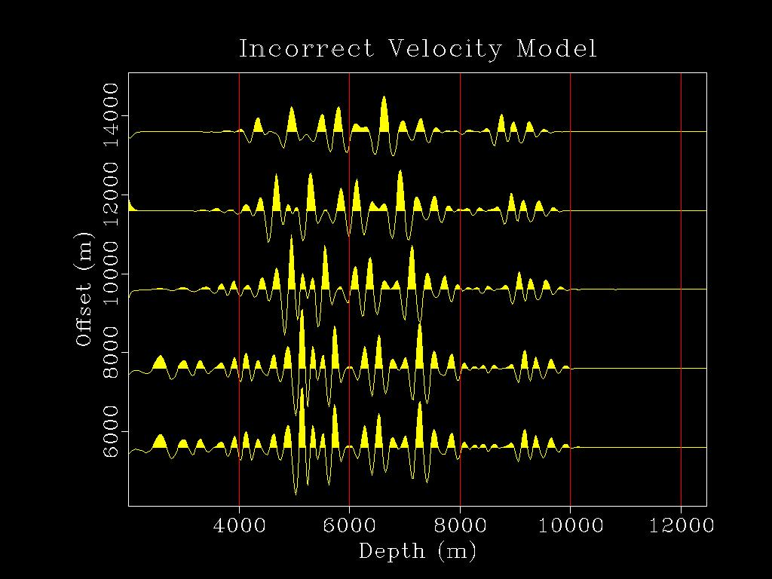
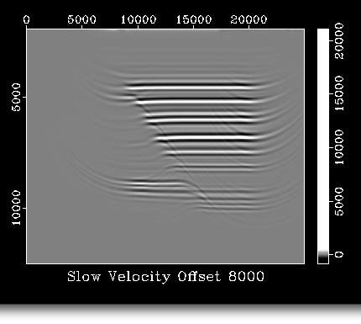
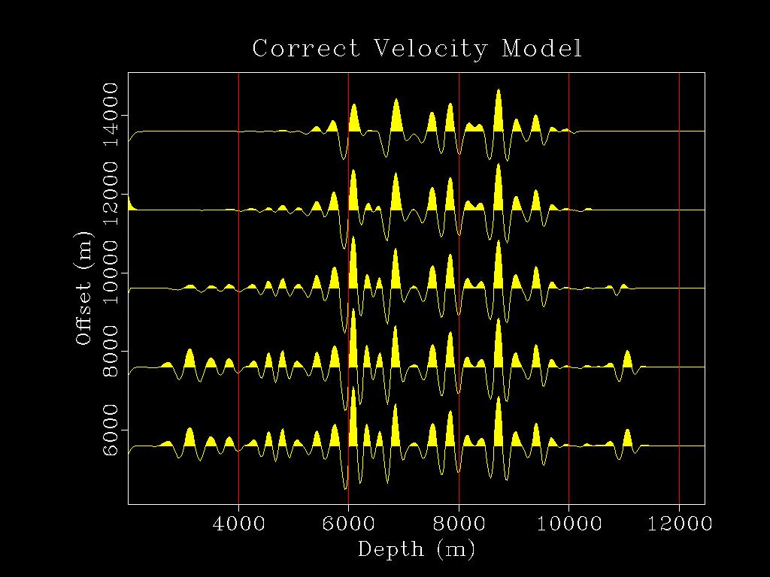
Invert each offset independently (Symes & Kern, 1994)
Include non-conformance in error term
Incorrect velocities
Correct velocities
Inverting models independently achieves data redundancy
The same point in the earth should appear the same at neighboring offsets if the background velocity is correct (Plessix, 2006).
7
Notes:
One offset it enough to form an image, but a survey has many, and my second contribution is to invert each of these offset images independently, an old concept from Symes and Kern 1984, but here applied to offset gathers– that’s the extended part of extended FWI. If I pick offsets that are close to each other, the earth doesn’t change much, and thus the same point should appear the same if the background velocity is correct. If it’s not, the reflections won’t line up. I can use this fact to include differences across offsets in the error term, to encourage FWI to find a background velocity to make them line up.

Slide 9
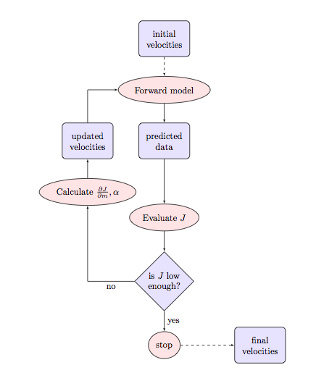
FWI
8

Slide 10
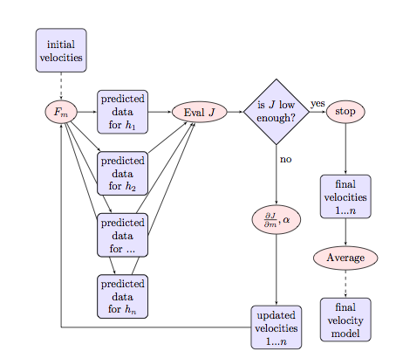
FWI
EFWI
9

Slide 11
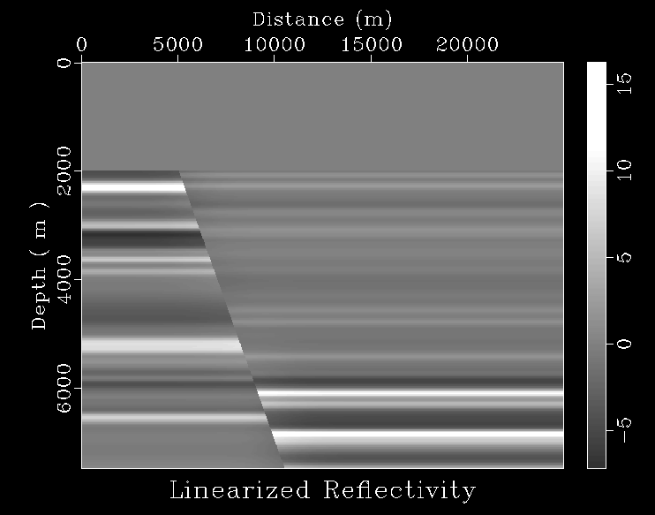
Linearized Born Modeling
r(x) =
10

Slide 12
Linearized (“Born”) Modeling
WHY????
10

Slide 13
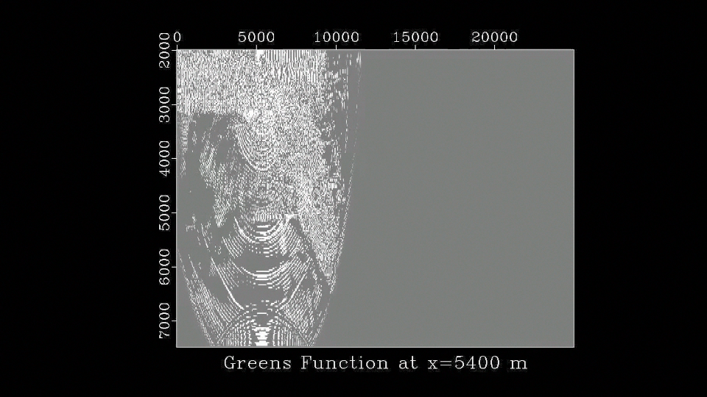
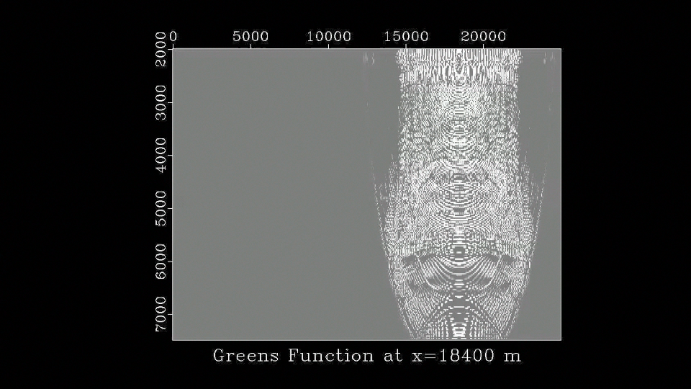
Greens functions
h₁
11

Slide 14
Greens functions
11

Slide 15
Forward modeling
EFWI
12

Slide 16
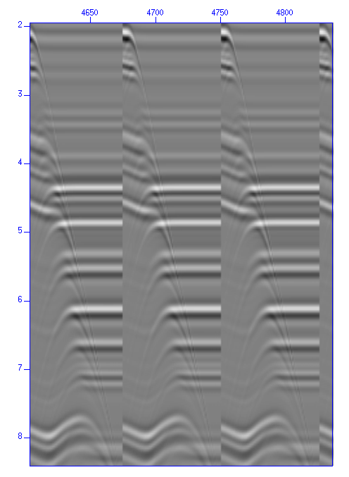
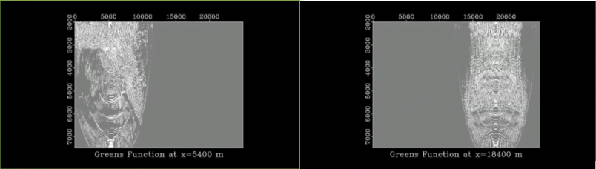
Forward modeling
13

Slide 17
Objective Function
Measures the difference between the predicted and recorded short wavelength component
14

Slide 18
Objective Function
Measures the difference between the predicted and recorded short wavelength component
Measures the difference between predicted and recorded short AND long wavelength component
15

Slide 19
Gradient calculation
Fits the short wavelength component
The gradient calculates the direction the model, r,
must change to decrease the error
16

Slide 20
Gradient calculation
Fits mostly the short wavelength component
Fits the short AND long wavelength component
The gradient calculates the direction the model, r,
must change to decrease the error
16

Slide 21
New model
EFWI
Model_new = Model_previous – Step_Length*Gradient
17

Slide 22
Progress Report
Extend FWI in the offset domain
  Develop Forward Operator
  Incorporate new Objective Function
  Gradient and Step length calculation
Invert Synthetic Data
Invert Field Data
In progress
In progress
18
Notes:
"To summarize, I will attempt to circumvent conventional pitfalls of FWI by changing the framework of the algorithm. Independent inversion of data gathers and use of semblance optimization has been shown in model studies to recover all length scales of the earth structure. I will develop a practical workflow for applying this algorithm, use synthetic studies to quantify the fidelity of the results, and exercise it with actual data to demonstrate the practicality of my implementation."

Slide 23
References
Odile Gauthier, Jean Virieux, and Albert Tarantola. Two-dimensional non- linear inversion of seismic waveforms: Numerical results. Geophysics, 51 (7):1387–1403, July 1986.
R. E. Plessix. A review of the adjoint-state method for computing the gradient of a functional with geophysical applications. Geophys. J. Int, 167:495–503, 2006.
Laurent Sirgue. Inversion de la forme d’onde dans le domaine frequential de donnees sismiques grands offsets. Ph.D. thesis, l’Ecole Normale Superieure de Paris, 2003.
William W. Symes and Michael Kern. Inversion of reflections seismograms by differential semblance analysis: algorithm structure and synthetic examples.
Geophysical Prospecting, 42:565-614, 1994.
J. L. Worzel. Cruise ig1904, June 1976. URL http://www.ig.utexas.edu/sdc/.
We gratefully acknowledge the support of BP America, Inc. and The Rice Inversion Project

