Slide 1
Papia Nandi-Dimitrova
Department of Earth Science, Rice University
6100 Main Street, Houston, TX 77005 papia.nandi@rice.edu / papia.nandi@bp.com
  PhD. Candidate in Geophysics, Rice University
  Seismic Specialist Geophysicist, BP
  Geophysicist Interpreter, BP
  Intern, ConocoPhillips
  Intern, Chevron
  MS Geophysics, University of Wyoming
  Post-Baccalaureate Fellow, Lawrence Berkeley Natl Lab
  Consultant, National Center for Supercomputing Appl
  BS Computer Science, University of Illinois
  BS Finance, University of Illinois
Present
2009-Present
2006-2009
2009
2009
2005
2002-2003
2002
2002
1997

Slide 2


Subsurface Imaging through Low-frequency Nonlinear Full Waveform Inversion
Papia Nandi-Dimitrova
under the direction of
William W. Symes

Slide 3
Inversion
Imaging the subsurface involves many unknowns
A function of acoustic and elastic parameters of the Earth

Slide 4
Inversion
F[m] = d
guess
given:
(Worzel, 1976)

Slide 5
Inversion
F[m] – d = 0
guess
given:
(Worzel, 1976)

Slide 6
Inversion
F[m] – d = E(m)
guess
given:
Length²(E(m))
=
=
(also known as the data residual and δd)
(Worzel, 1976)

Slide 7
Traditional Full waveform inversion (FWI)
gradient
scale
m_{k+1}= m_{k} + scale × gradient

Slide 8
Proposed Nonlinear FWI
gradient
scale
m_{k+1}= m_{k} + scale × gradient
alter d

Slide 9
Traditional FWI data input
A Shot
Gather

Slide 10
Traditional FWI data input
A Shot
Gather
h₁
h = offset

Slide 11
Traditional FWI data input
h₂
A Shot
Gather
h₁
h = offset [1,2,3….n]

Slide 12
Traditional FWI data input
A Shot
Gather
choose a single offset
h = offset

Slide 13
Traditional FWI data input
A Shot
Gather
choose a single offset
which, for several shots,
h = offset

Slide 14
Traditional FWI data input
A Shot
Gather
choose a single offset
which, for several shots, approximates a plane
h = offset

Slide 15
Traditional FWI data input
A Shot
Gather
choose a single offset
which, for several shots, approximates a plane
= an offset gather
h = offset

Slide 16
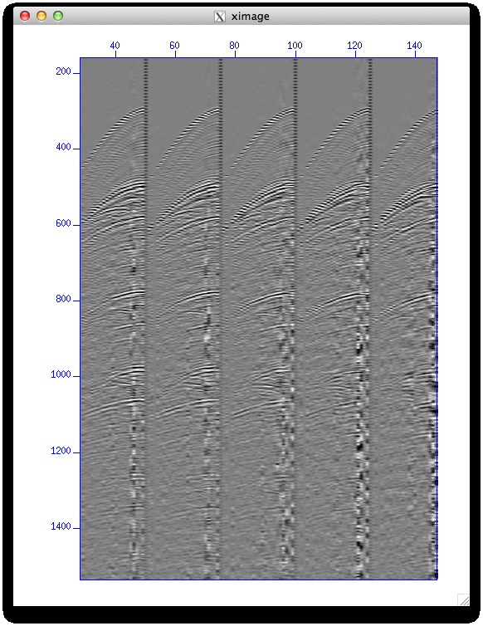
Traditional FWI data input
20
Shot gathers
(Worzel, 1976)

Slide 17
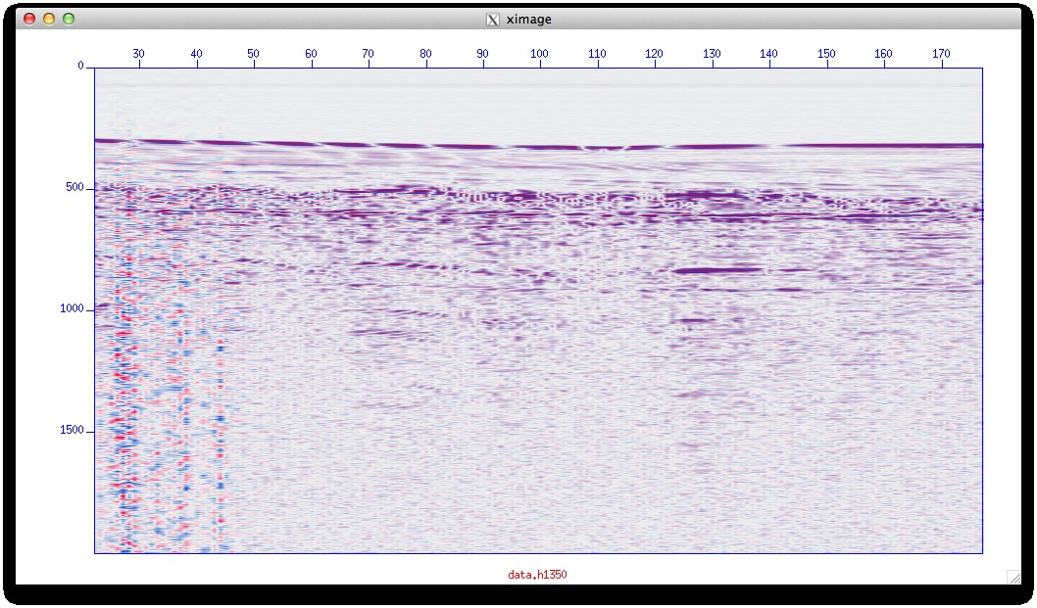
Proposed FWI data input
20
Offset gathers h=1350
(Worzel, 1976)

Slide 18
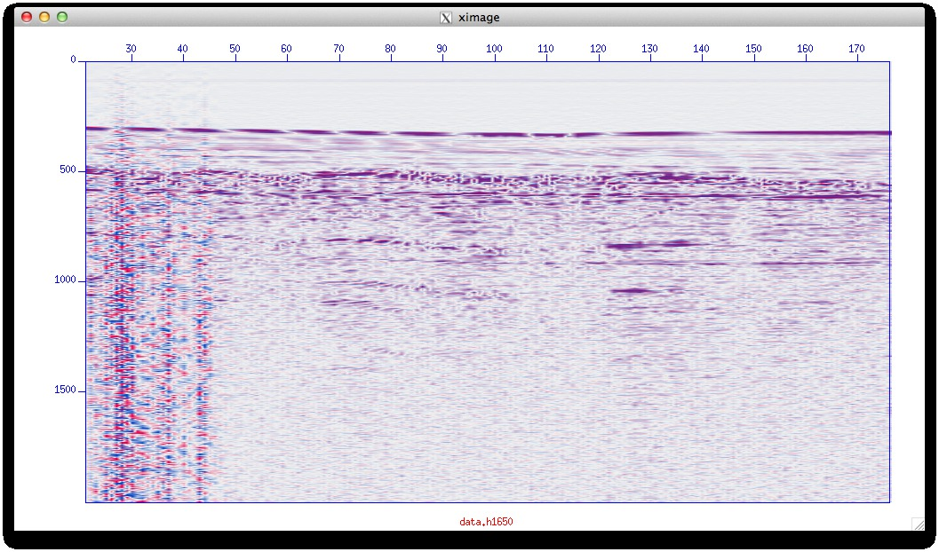
Proposed FWI data input
Offset gathers h=1650
(Worzel, 1976)

Slide 19
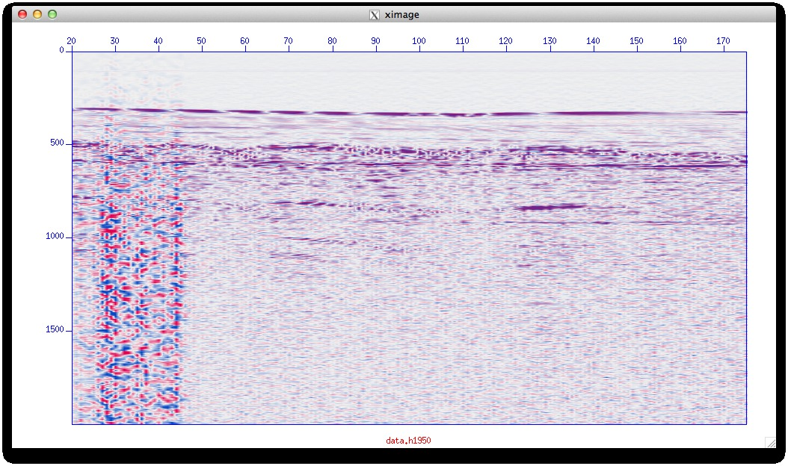
Proposed FWI data input
Offset gathers h=1950
(Worzel, 1976)

Slide 20
Proposed FWI data input
Offset gathers h=1950
(Worzel, 1976)
Use this redundancy to estimate the long wavelength component

Slide 21
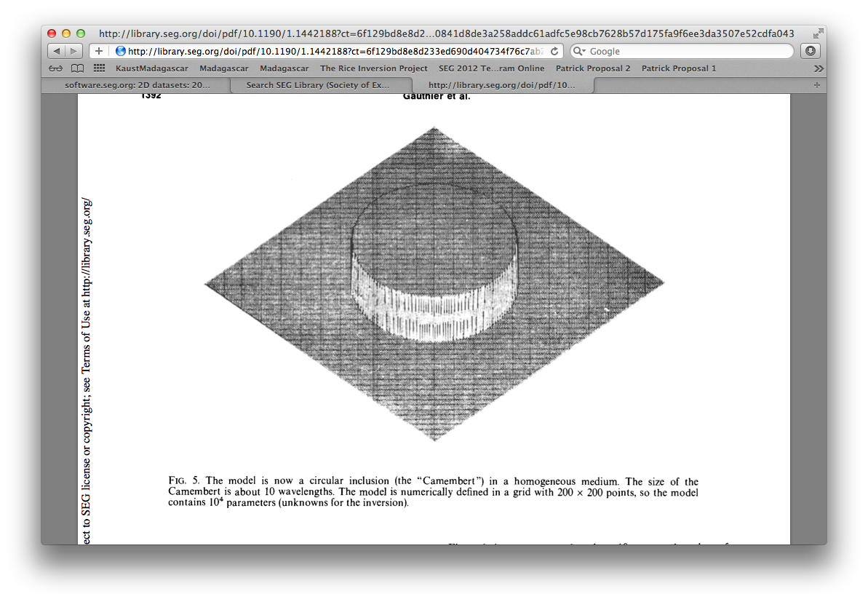
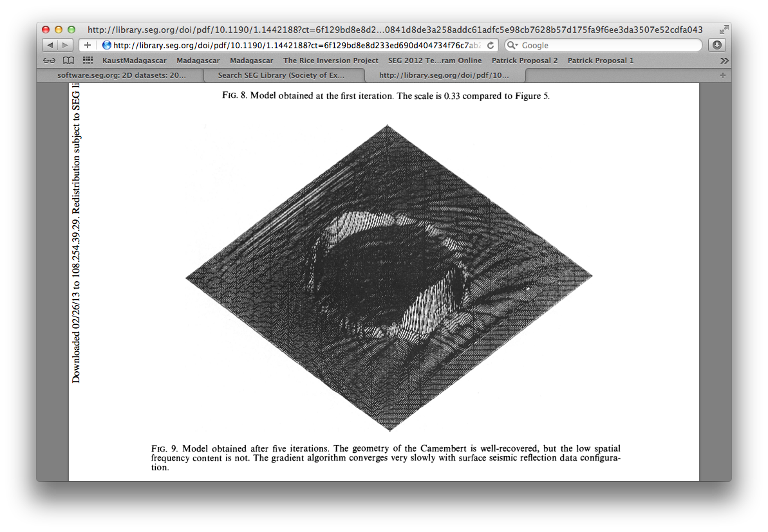
FWI is an ill-posed problem
Traditional FWI challenges
Gauthier, et al. 1986
true model
inverted result
The low spatial frequency components of the model are hard to recover – they are non-linear to F[m]
(also known as long wavelength, λ, or background velocity)

Slide 22
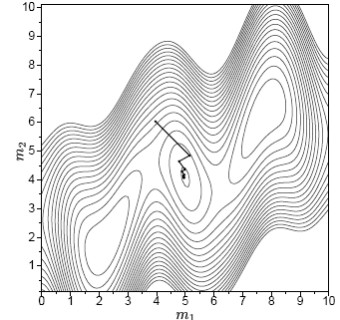
Traditional FWI challenges
FWI is an ill-posed problem
Sirgue, 2003
The low spatial frequency components of the model are hard to recover– they are non-linear to F[m]
This leads to the existence of many local minima in the solution space
(also known as long wavelength, λ, or background velocity)

Slide 23
Proposed Nonlinear FWI
gradient
scale
m_{k+1}= m_{k} + scale × gradient
alter d
add short λ component:
after Symes & Carrazone, 1991
(also known as reflectivity, or the scattered wavefield)

Slide 24
Proposed Nonlinear FWI
gradient
scale
m_{k+1}= m_{k} + scale × gradient
alter d
add short λ component:
  add a dimension to m
after Symes & Carrazone, 1991
(also known as extended modeling
and is part of differential semblance optimization or DSO)

Slide 25
Proposed Nonlinear FWI
gradient
scale
m_{k+1}= m_{k} + scale × gradient
alter d
add short λ component:
  add a dimension to m
  invert each h separately
after Symes & Carrazone, 1991

Slide 26
Proposed Nonlinear FWI short λ component

Slide 27
Proposed Nonlinear FWI short λ component

Slide 28
Proposed Nonlinear FWI short λ component
…..

Slide 29
Proposed Nonlinear FWI short λ component
…..

Slide 30
Proposed Nonlinear FWI short λ component
…..

Slide 31
Proposed Nonlinear FWI short λ component
…..
This helps to achieve data redundancy

Slide 32
Proposed Nonlinear FWI short λ component
…..
This helps to achieve data redundancy
The same point in the earth should appear the same at neighboring offsets if the background velocity is correct (Plessix, 2006).

Slide 33
Proposed Nonlinear FWI short λ component
…..
This helps to achieve data redundancy
The same point in the earth should appear the same at neighboring offsets if the background velocity is correct (Plessix, 2006). Add a step to encourage the inversion to make the background the same for each offset.

Slide 34
Proposed Nonlinear FWI
gradient
scale
m_{k+1}= m_{k} + scale × gradient
alter d
add short λ component:
  add a dimension to m
  invert each h separately
add long λ component
after Symes & Kern, 1994

Slide 35
Proposed Nonlinear FWI– long λ component
Step 4) add long λ component
i=offset number
we want to minimize the value of this entire expression

Slide 36
Proposed Nonlinear FWI– long λ component
Step 4) add long λ component
A measure of flatness across a common midpoint (CMP) gather
FIT
MOSTLY short λ component
σ² is small
AND long λ component
σ² is large

Slide 37
Proposed Nonlinear FWI– long λ component
Step 4) add long λ component
A measure of flatness across a common midpoint (CMP) gather
FIT
MOSTLY short λ component
σ² is small
AND long λ component
σ² is large
We can control what we want to fit by changing the value of σ

Slide 38
Proposed Nonlinear FWI – long λ component
Step 4) add long λ component
A measure of flatness across a common midpoint (CMP) gather
FIT
MOSTLY short λ component
σ² is small
AND long λ component
σ² is large
We can control what we want to fit by changing the value of σ
Strategy:
Fit the short λ component first, to avoid local minima
Fit the long λ component next
Symes & Kern, 1994

Slide 39
Proposed Nonlinear FWI – strategy
Fit the short λ component first, to avoid local minima
Fit the long λ component next
A local minimum
solving for long & short λ simultaneously
short λ
solving for short λ first then long λ separately
long λ
A schematic representation of convergence

Slide 40
Proposed Nonlinear FWI – strategy
Fit the short λ component first, to avoid local minima
Fit the long λ component next
We expect this method to converge to a solution (100’s of times) faster
A local minimum
solving for long & short λ simultaneously
short λ
solving for short λ first then long λ separately
long λ
A schematic representation of convergence

Slide 41
Proposed Nonlinear FWI
gradient
scale
m_{k+1}= m_{k} + scale × gradient
alter d
add short λ component:
  add a dimension to m
  invert each h separately
add long λ component
alter gradient

Slide 42
Proposed Nonlinear FWI – gradient calculation
J = = prediction error
The gradient calculates the direction the model, m,
must change to decrease the error
gradient
scale
m_{k+1}= m_{k} + scale × gradient
(J is also known as the objective function)

Slide 43
Proposed Nonlinear FWI – gradient calculation
J = = prediction error
The gradient calculates the direction the model, m,
must change to decrease the error
The scale calculates how large this change should be
gradient
scale
m_{k+1}= m_{k} + scale × gradient
(J is also known as the objective function)

Slide 44
Proposed Nonlinear FWI – gradient calculation
J = = prediction error
The gradient calculates the direction the model, m,
must change to decrease the error
The scale calculates how large this change should be
The new model is m_{k+1}
gradient
scale
m_{k+1}= m_{k} + scale × gradient
(J is also known as the objective function)

Slide 45
Proposed Nonlinear FWI – gradient calculation
can also be expressed in terms of Green’s functions

Slide 46
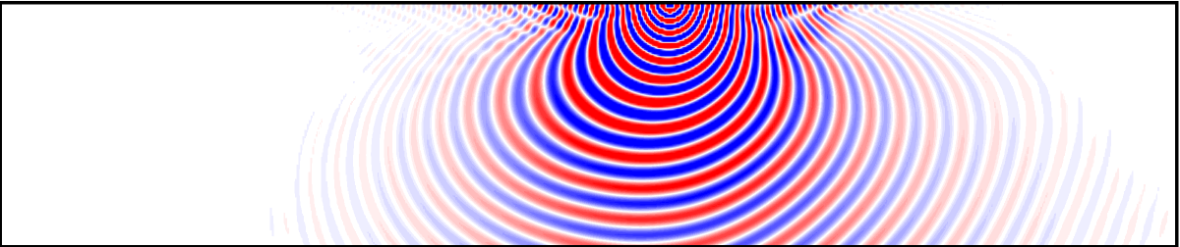
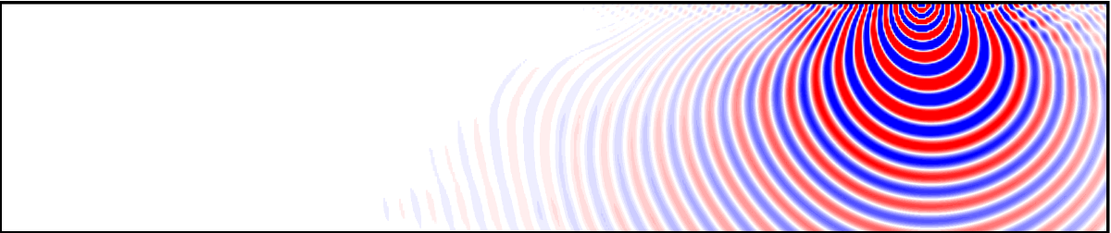
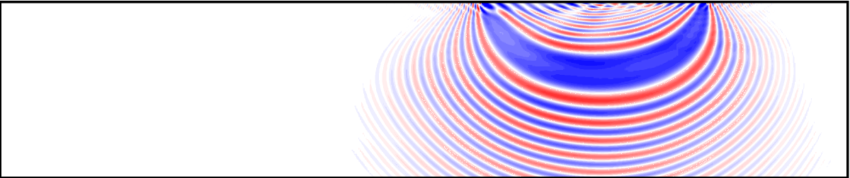
Proposed Nonlinear FWI – gradient calculation
Brenders & Pratt, 2007

Slide 47
Proposed Nonlinear FWI – gradient calculation
=T
can also be expressed in terms of Green’s functions
A differencing operator

Slide 48
Proposed Nonlinear FWI – gradient calculation
=T
can also be expressed in terms of Green’s functions
A differencing operator

Slide 49
Proposed Nonlinear FWI – gradient calculation
=T
can also be expressed in terms of Green’s functions
A differencing operator
…. Complicated refer to Lailly, 1983

Slide 50
Proposed Nonlinear FWI – gradient calculation
=T
can also be expressed in terms of Green’s functions
A differential operator
…. Complicated refer to Lailly, 1983
The gradient,
Lailly, 1983

Slide 51
Proposed Nonlinear FWI – gradient calculation
The gradient,
The equation for Reverse Time Migration (RTM)
Whitmore, 1983

Slide 52
Proposed Nonlinear FWI – gradient calculation
The gradient,
The equation for Reverse Time Migration (RTM)
Whitmore, 1983
We can use this similarities to incorporate algorithms that use the wave-equation and preserve offsets:
1) Wave-equation Kirchhoff (Etgen, 2012, Ehinger,1996)
2) RTM surface offset gathers (Giboli, et al, 2012)

Slide 53
Proposed Nonlinear FWI – gradient via
Wave-equation Kirchhoff
/
x
z
Velocity model
Calculate a Green’s function for every source/receiver point in the survey
Ehinger, 1996; Etgen, 2012

Slide 54
Proposed Nonlinear FWI – gradient via
Wave-equation Kirchhoff
/
x
z
Velocity model
Calculate a Green’s function for every source/receiver point in the survey
Convolve source and receiver Green’s functions from a table
Re-use Green’s functions as appropriate
Ehinger, 1996; Etgen, 2012

Slide 55
Proposed Nonlinear FWI – gradient via
RTM Surface Offset Gathers
Use traditional RTM to obtain an image
Giboli, et al. 2012

Slide 56
Proposed Nonlinear FWI – gradient via
RTM Surface Offset Gathers
Use traditional RTM to obtain an image
Use an offset-scaled RTM to obtain another image
Giboli, et al. 2012

Slide 57
Proposed Nonlinear FWI – gradient via
RTM Surface Offset Gathers
Use traditional RTM to obtain an image
Use an offset-scaled RTM to obtain another image
Divide one by the other to get a mapped image of offsets
Offset map =
Giboli, et al. 2012

Slide 58
Proposed Nonlinear FWI – gradient via
RTM Surface Offset Gathers
Use traditional RTM to obtain an image
Use an offset-scaled RTM to obtain another image
Divide one by the other to get a mapped image of offsets
Offset map =
Sort traces into offset gathers using the offset map
Giboli, et al. 2012

Slide 59
Proposed Nonlinear FWI
gradient
scale
m_{k+1}= m_{k} + scale × gradient

Slide 60
Proposed Nonlinear FWI - Implications
We don’t have to have good starting velocity model

Slide 61
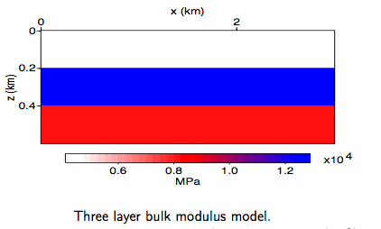
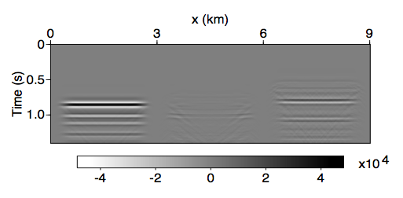
Proposed Nonlinear FWI - Implications
We don’t have to have good starting velocity model
Can use the inversion to predict multiples
Sun, et al., 2012

Slide 62
Proposed Nonlinear FWI - Implications
We don’t have to have good starting velocity model
Can use the inversion to predict multiples
Multiple removal (including interbed multiples)
Imaging with multiples
Sun, et al., 2012

Slide 63
Thank you
Andrew Brenders and R. Gerhard Pratt. personal communication, 2007.
John Etgen. 3d wave equation Kirchhoff Migration. In 2012 SEG Annual Meeting, 2012. Society of Exploration Geophysicists, 2012.
Ehinger, A., P. Lailly, and K. J. Marfurt, 1996, Green's function implementation of common-offset waveequation migration: Geophysics, 61, 1813–1821.
Odile Gauthier, Jean Virieux, and Albert Tarantola. Two-dimensional non- linear inversion of seismic waveforms: Numerical results. Geophysics, 51 (7):1387–1403, July 1986.
Matteo Giboli, Reda Baina, and Bertrand Duquet. Reverse time migration surface offset gathers part 1: a new method to produce ’classical’ common image gathers. In 2012 SEG Annual Meeting, 2012. Society of Exploration Geophysicists, 2012.
Patrick Lailly. The seismic inverse problem as a sequence of pre-stack migration. In J. B. Bednar, R. Redner, E. Robinson, and A. Weglein, editors, Conference on inverse scattering: Theory and Applications. Society of Industrial and Applied Mathematics, Society of Industrial and Applied Mathematics, 1983.
R. E. Plessix. A review of the adjoint-state method for computing the gradient of a functional with geophysical applications. Geophys. J. Int, 167:495–503, 2006.
Laurent Sirgue. Inversion de la forme d’onde dans le domaine frequential de donnees sismiques grands offsets. Ph.D. thesis, l’Ecole Normale Superieure de Paris, 2003.
Dong Sun and William W Symes. Waveform inversion via nonlinear differential semblance optimization. In Expanded Abstracts, page S13.3. Society of Exploration Geophysicists, 2012.
William W. Symes and Michel Kern. Inversion of reflections seismograms by differential semblance analysis: algorithm structure and synthetic ex- amples. Geophysical Prospecting, 42:565–614, 1994.
William W. Symes and J. J. Carazzone. Velocity inversion by differential semblance optimization. Geophysics, 56:654–663, 1991.
N. D. Whitmore. Iterative depth migration by backward time propagation. In Expanded Abstracts, page S10.1. Society of Exploration Geophysicists, 1983.
J. L. Worzel. Cruise ig1904, June 1976. URL http://www.ig.utexas.edu/sdc/.
We gratefully acknowledge the support of BP America, Inc. and The Rice Inversion Project

