Slide 1
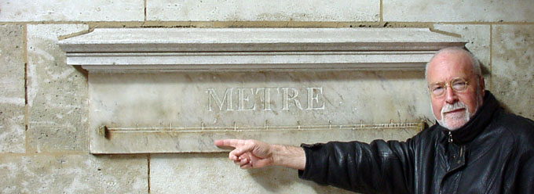
Mr. Inversion, 80’s – early 90’s: Albert Tarantola
Basic properties of seismic inversion via least squares and Newton’s method
Practical algorithms for least-squares inversion
Bayesian framework (“solution = a posteriori pdf”)

Slide 2
Disaster!
After a flurry of interest in the 80’s, industry interest waned because…
It didn’t work!
Newton’s method converges to local min poorly fitting data
Illustration based on Marmousi model…

Slide 3
0%

Slide 4
100 %

Slide 5
95%

Slide 6
90%

Slide 7
80%

Slide 8
70%

Slide 9
100% - RMSE = 0%
Shot record 121 – model 100%
Data error
model 100% - model100%

Slide 10
95% - RMSE = 184%
Shot record 121 – model 95%
Data error
model 95% - model100%

Slide 11
90% - RMSE = 144%
Shot record 121 – model 90%
Data error
model 90% - model100%

Slide 12
80% - RMSE = 179%
Shot record 121 – model 80%
Data error
model 80% - model 100%

Slide 13
70% - RMSE = 216%
Shot record 121 – model 70%
Data error
model 70% - model 100%

Slide 14
60% - RMSE = 273%
Shot record 121 – model 60%
Data error
model 60% - model 100%

Slide 15
Kolb et al. 86: frequency continuation w low starting freq increases chances of convergence
Bunks et al. 95: success with Marmousi, very low frequency data (0.25 Hz – compare typical 3-5 Hz)
Gerhard Pratt: many “algorithmic engineering” contributions over the 90’s – exponential damping,
frequency decimation, traveltime tomography for initial models
Upshot: functional least-squares inversion for transmission data

Slide 16
BP blind test at EAGE 04: Pratt’s result rekindles interest in least-squares inversion by Newton
now called “Full Waveform Inversion” (FWI)
Every major firm has large team working on FWI
Many successful field trials reported
Math has not changed since Tarantola:
Limited mostly to transmission
Requires very low frequency data with good s/n, or very good starting model
(Brenders & Pratt, SEG 07)

Slide 17
Origin of Extended Modeling
A dinner conversation in 1984:
Me: “Least squares inversion doesn’t work, whine, whine”
Industry buddy: “We geophysicists find seismic models thousands of times, every day, all over the world. What’s wrong with you mathematicians?”
Me: “Ummm…”

Slide 18
Extended Modeling and Inversion
Idea embedded in geophysical practice since 60’s, maybe before (Dobrin, p 234):
Don’t need entire survey for inversion – can estimate (eg.) one model per shot record – an underdetermined problem!

Slide 19
100%
90%
80%
Three inversions of shot 61 with different starting models

Slide 20
Extended Modeling and Inversion
Select (somehow) an inversion for each shot
Creates an extended model – depends on an extra parameter (shot number or position), fits data
Special case – models same for all shots – solution of original inverse problem!

Slide 21
An extended inversion of Marmousi data

Slide 22
Semblance
There is only one earth: Amongst all extended models fitting the data, choose one that isn’t extended – all single-shot inversions same!
Central issues: (i) how to navigate extended models efficiently, (ii) how to measure semblance = extent to which all models are same
Like split-screen focusing

Slide 23
100%
90%
80%
Slice of inverted extended model volumes as function of initial data along shot axis for horizontal position 4.2 km – exhibits extent of semblance violation

Slide 24
Differential Semblance
Measure degree of dependence on extra param (shot) by differentiation
|F[c]-d|² + α|D_{s}c|²
Most studied variant: replace F[c] with F[v]r, extend r only – then
min_{r} [|F[v]r-d|²+α|D_{s}r|] = < d, P[v] d>
with P[v] = ΨDO dep smoothly on v
A smoothly turning focusing knob!

Slide 25
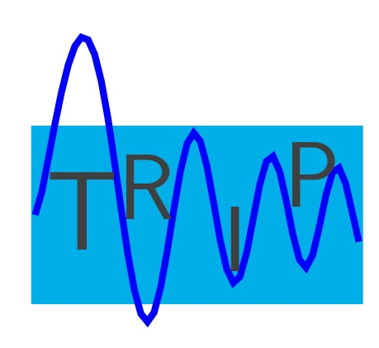
BEFORE
Seismic Autofocus by Differential Semblance
Version developed in Peng Shen’s PhD thesis: redundant parameters via operator coefficents in wave equation.
Applied to exploration survey, southern Caribbean – distortion of subsurface structure due to gas chimney. DS correctly locates gas, focuses inversion to reveal structure
[P. Shen & W. Symes, Geophysics 2008] – Thanks: Shell
AFTER

Slide 26
Review paper on FWI, velocity analysis, semblance etc.: WWS, Inverse Problems, 2009
Many recent conference papers on extended model inversion, including nonlinear version (F[c] instead of F[v]r)
FWI without “low” frequencies appears feasible – but theory needed!!!!

Slide 27
Thanks to…
students and collaborators
Sponsors of The Rice Inversion Project
Gunther, Laurent, Sean, Russ, Francois
MSRI and NSF
And to all of you for listening!

